Slide 2


Notes:
1. Late summer, at home, watch them grow, pears, apples, berries
2. Pored in love, time, effort
1. One morning…

Slide 3


Notes:
1. It was all gone…
2. The culprit. Deer
3. This is my revenge story.

Slide 4
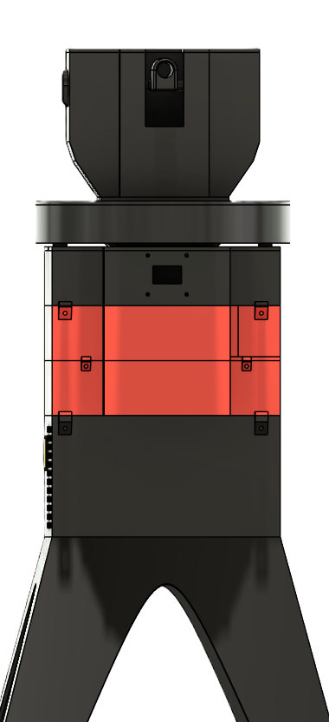

SENTRY

Slide 5

SENTRY

Slide 6
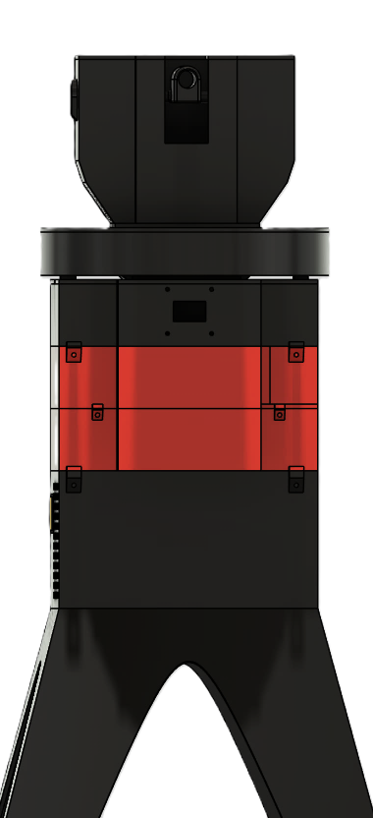
+ + + + +
+ + + + +
+ + + +
SENTRY
Notes:
Not the only person

Slide 7
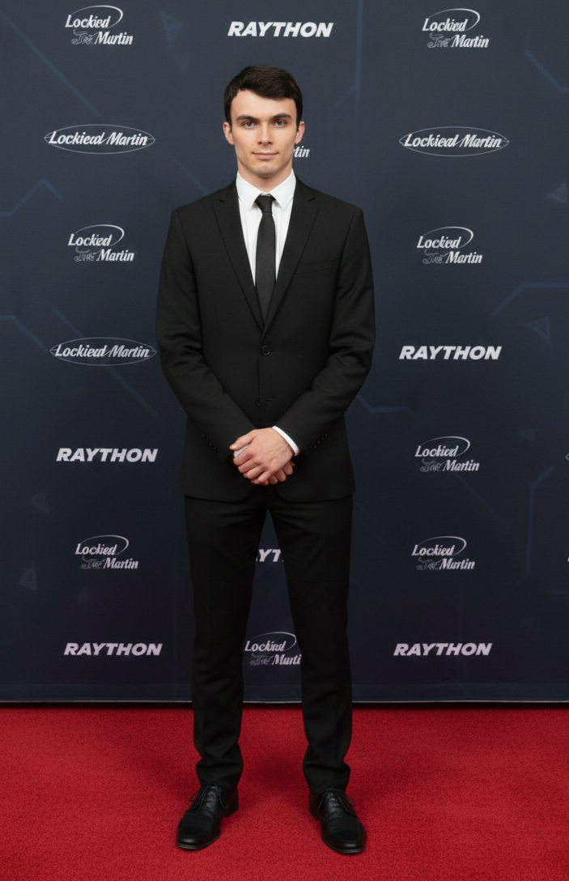
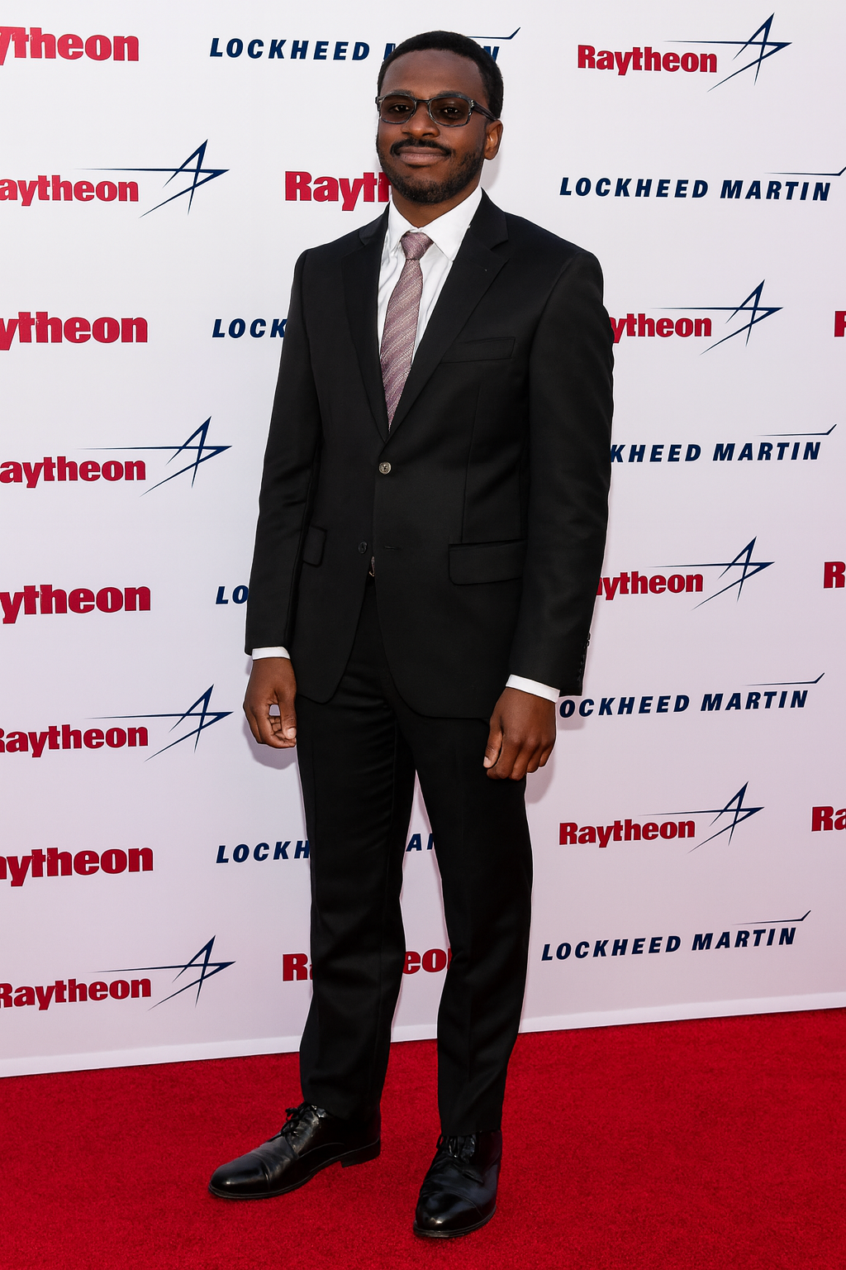
Our Team
Mark Gladkevitch
Amaziah Kinavuidi
Notes:
Before we get into the project details, we’ll briefly introduce our team. I’m Amaziah, the lead software engineer who trained the AI computer-vision model and programmed the device.

Slide 8



Slide 9
Agenda
Project Overview
Project overview
Hardware
  PCB
  Parts used and deterrents
Software
  Tracking model
  Motor control
Final Remarks
Notes:
Now, this is what we will table about today. We’ll go over what our project is and what it does, then then dive deep into the hardware and software aspect of our project. And at the end, we’ll make a few closing remarks.

Slide 10
Project Overview
Notes:
An ai computer vision model …………

Slide 11

Project Overview
DETECT
DETER
Notes:
So, our Sentry Project It can be summed up in two words: detect and deter — which is our two main goals. If you remember only one thing today, let it be that.

Slide 12
Project Overview
What is the sentry turret and what does it do?
The sentry turret is an autonomous system that uses an AI model to detect, track and deter deer using a laser.
DETECT
DETER
Notes:
So How does it work?
It’s an autonomous AI-powered system that detects, tracks, and deters deer with a laser. From the start, we focused on making it fast, accurate, and reliable—something people can use to protect their property and plants.

Slide 13




Hardware
Brains
Movement
Sensing
Power

Slide 14
Hardware
Brains
Movement
Sensing
Power

Slide 15
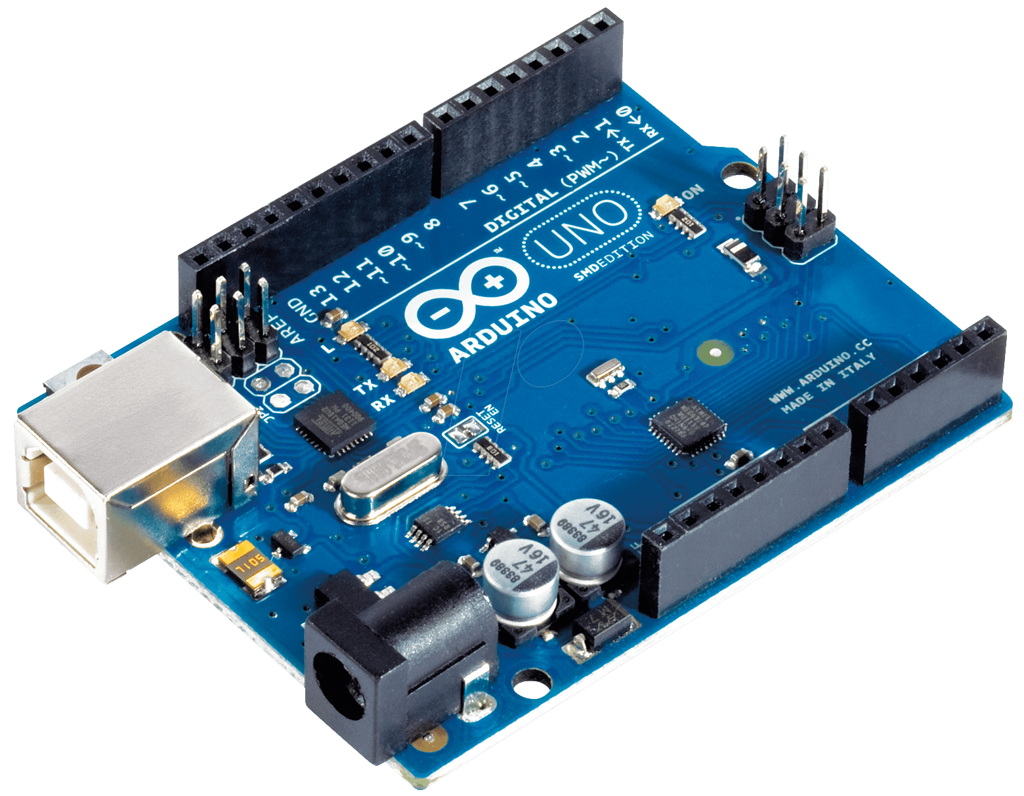
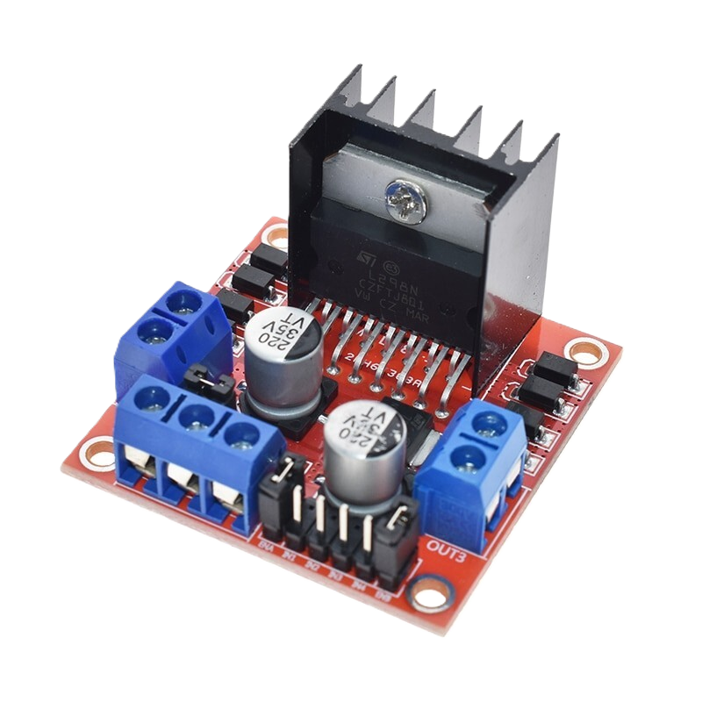
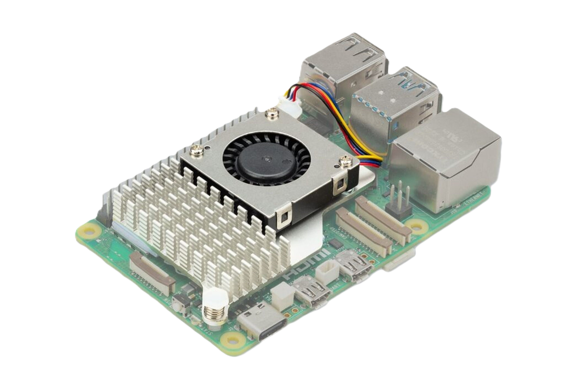
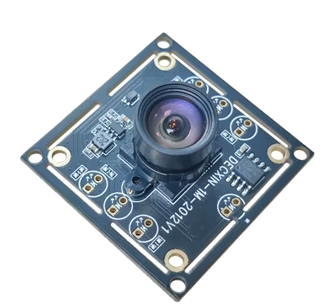
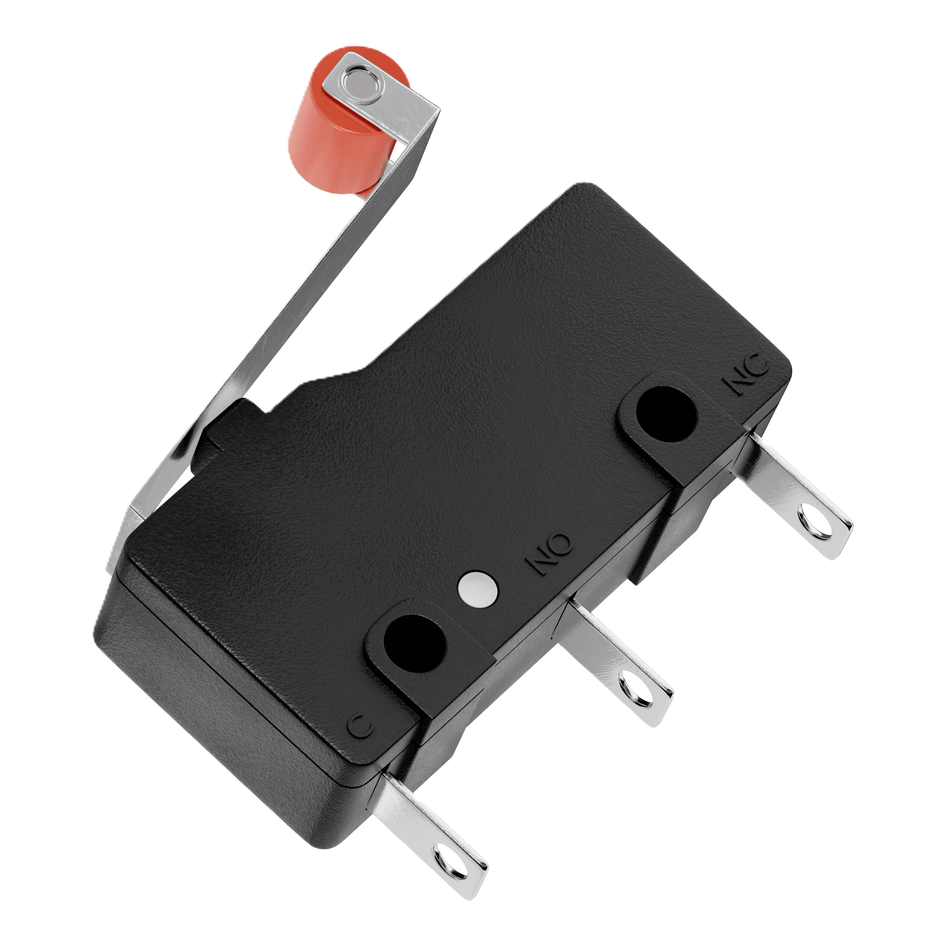
Hardware
Arduino
Plenty of experience
Great for controling motors, sensors, deterrents
Motor Control Module
Available in electronics prep room
Can handle high currents (over 1.5A)
Raspberry Pi
Powerful/Fast chipset (2.4Ghz)
Easy to operate and program
Wide array of available connections
100-degree field of view (FOV)
USB type A connector
Capable of 30 frames per second (fps) at 1280x720 pixel resolution
Night vision capable with IR CUT filter
Brains
Motion
Sensing
Power
Sets turning distance boundaries
Sets homepoint
Notes:
Stress how it aligns with our goal to make it precise and accurate

Slide 16
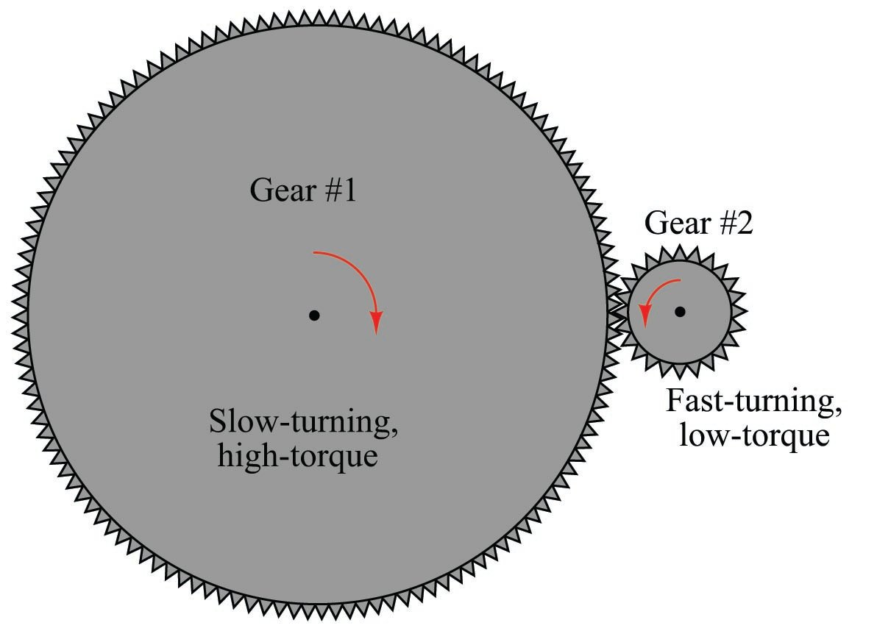
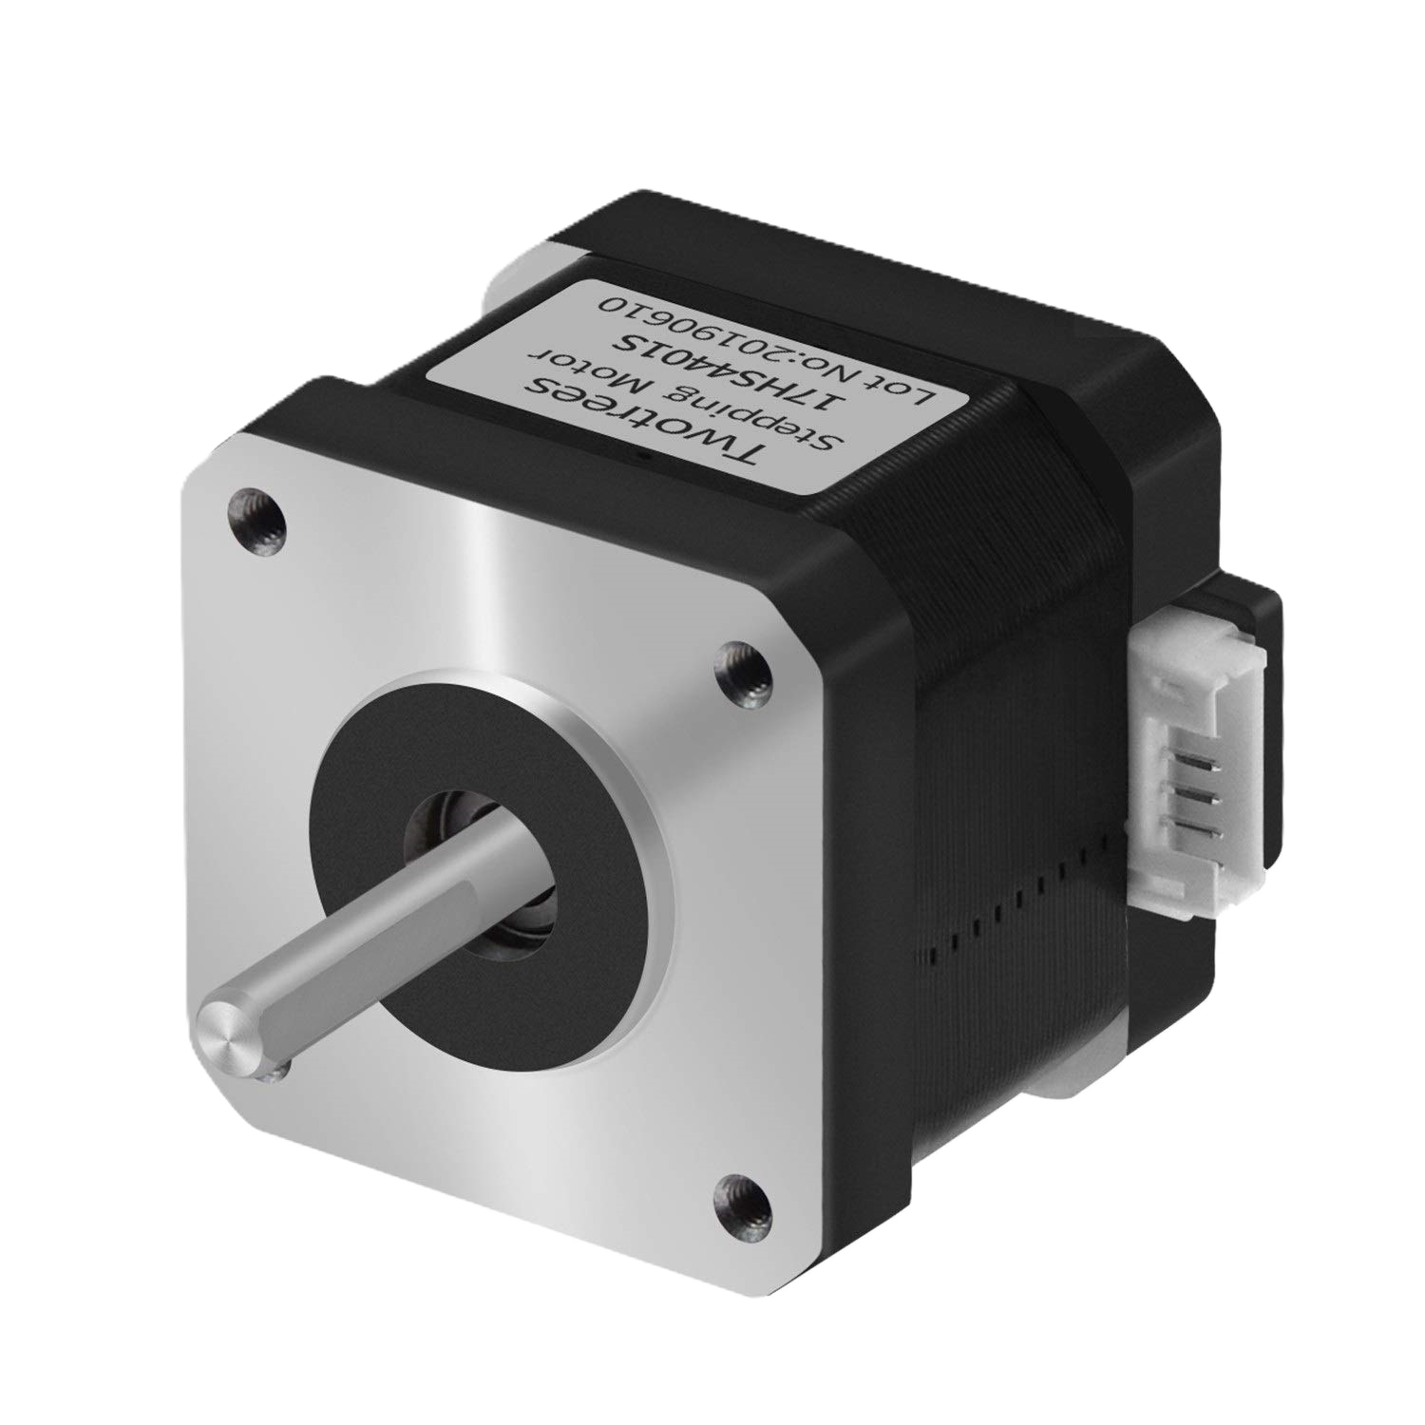
10:1 Gears
Sacrificing speed for higher torque
Can turn more weight
NEMA 17 Stepper Motor
High speed (1200rpm)
Precise
Cheap(er)
Arduino
Plenty of experience
Great for controlling motors, sensors, deterrents
Brains
Motor Control Module
Available in electronics prep room
Can handle high currents (up to 2A)
Motion
Sensing
Power
Raspberry Pi
Powerful/Fast chipset (2.4Ghz)
Easy to operate and program
Wide array of available connections
100-degree field of view (FOV)
USB type A connector
Capable of 30 frames per second (fps) at 1280x720 pixel resolution
Night vision capable with IR CUT filter
Sets turning distance boundaries
Sets homepoint

Slide 17
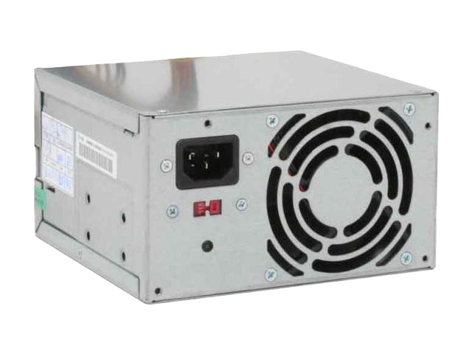
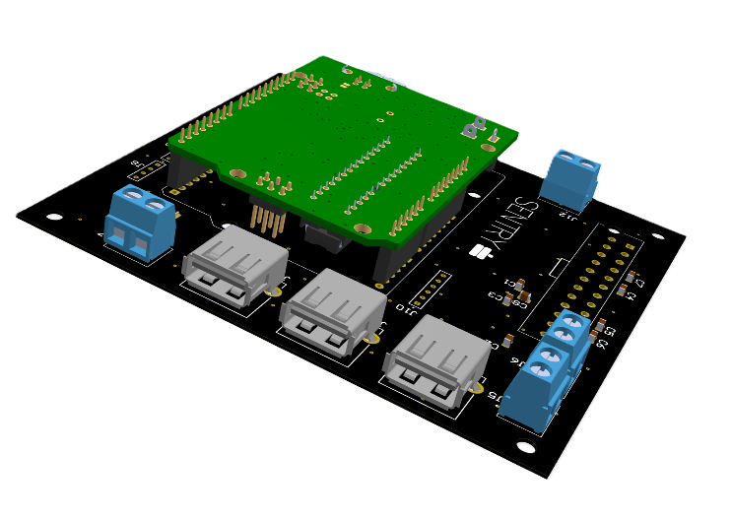
Has many different available voltages (3.3V, 5V, 12V)
High current availability
Free
10:1 Gears
Brains
Sacrificing speed for higher torque
Can turn more weight
Motion
Sensing
NEMA 17 Stepper Motor
Power
High speed (1200rpm)
Precise
Cheap(er)

Slide 18
ATX Power Supply
Brains
Motion
Sensing
Has many different available voltages (3.3V, 5V, 12V)
High current availability
Free
Power
10:1 Gears
Sacrificing speed for higher torque
Can turn more weight
NEMA 17 Stepper Motor
High speed (1200rpm)
Precise
Cheap(er)

Slide 19
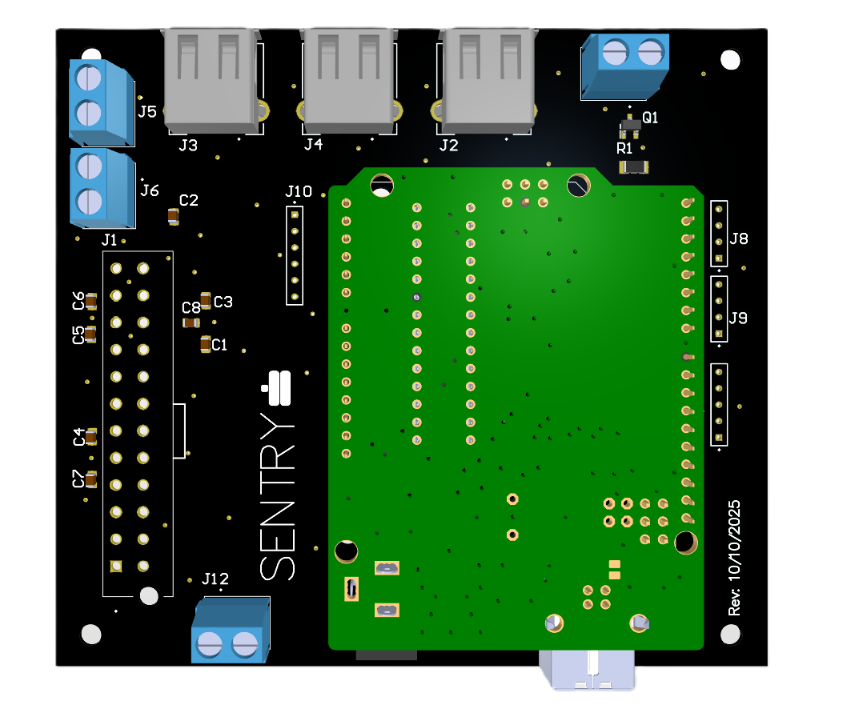
Has many different available voltages (3.3V, 5V, 12V)
High current availability
Free
Extra USB type A
Brains
Screw terminals
Motion
Sensing
Extra I/O pins
PSU connector
Power
All power cords from devices merged into one wall outlet cord
Arduino mount + extra free I/O pins
Mounted Arduino Uno
10:1 Gears
Sacrificing speed for higher torque
Can turn more weight
NEMA 17 Stepper Motor
High speed (1200rpm)
Precise
Cheap(er)

Slide 20

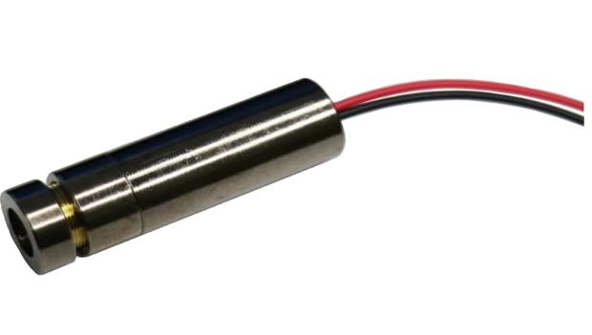

Deterrents
5mW Green Laser
Aiming for sub 10 Minute Of Angle (MOA)
1 MOA = deviation of 1 inch per 100 yards
(For proof of concept)

Slide 21


Slide 22
Software

Slide 23
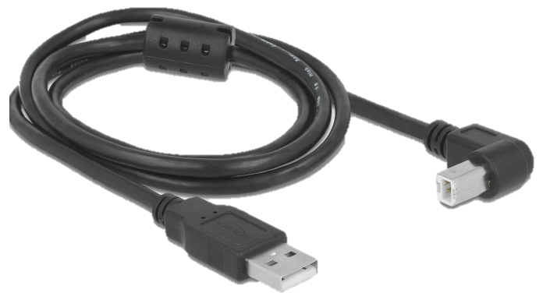
Software
Computer vision
Deterrents control
Programmed in python
Capture frames from the USB cam and run inference on it
Programmed in C using the Arduino IDE
Control the movement of the laser and its activation

Slide 24

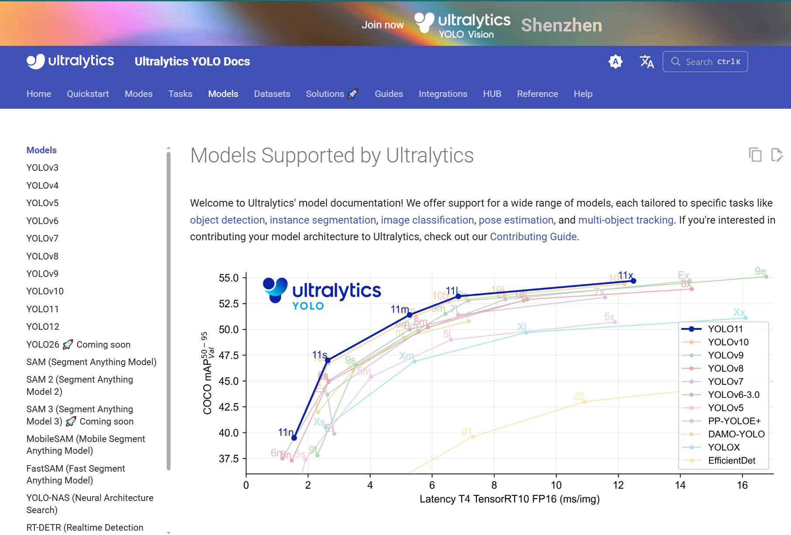
Software
Computer vision - YOLO AI model
Computer vision
Deterrents control
Using an Ultralytics YOLO AI model
Ultralytics is a software company that develops and provides open-source models
Programmed in python
Capture frames from the USB cam and run inference on it
Programmed in C using the Arduino IDE
Control the movement of the laser and its activation
Notes:
Our software is made up of 2 different parts, computer vision on the pi 5 which is programmed in python. That handles the capturing of frames from our usb cam and running inference on it to check for detections. If there’s a detection, it grabs the coordinates of the deer within that frame and sends it to the Arduino uno. The Arduino microcontroller is programmed in c using the Arduino software. It receives the coordinates from the pi 5 then does some conversions to move the motors.

Slide 25
Computer vision - YOLO AI model
Using an Ultralytics YOLO AI model
Ultralytics is a software company that develops and provides open-source models
Notes:
Now let’s dive deeper into the computer vision section. So, we’re using YOLO AI model by ultralytics. Ultralytics is basically a computer vision AI company that develops and provides open-source solutions models.

Slide 26
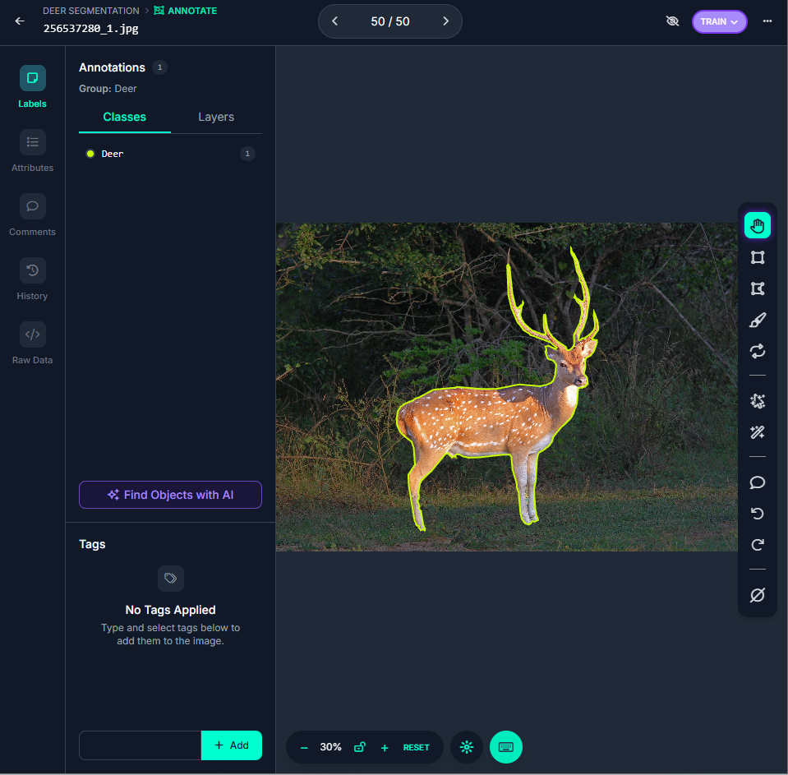
Computer vision – YOLO AI model cont.
Computer vision – Training a model
Deer dataset of 1211 images from Roboflow
Add preprocessing and augmentation layers to have a diverse set of images
Trained models with 70 -100 epochs
Notes:
From all of those available models. We chose the nano version of the yolov8 model because it was one of the fastest models that runs well within the pi 5 capabilities. It is fast and provides accurate results as well.

Slide 27
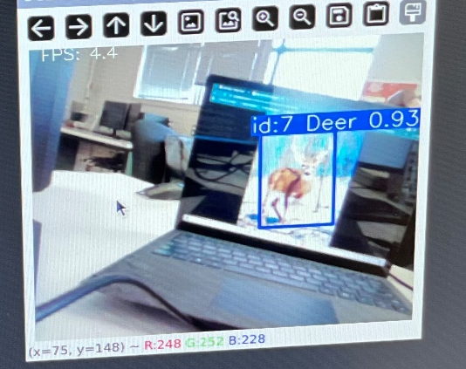
Computer vision – YOLO AI model cont.
Computer vision – Test
Computer vision – Training a model
For every detected deer, a bounding box is drawn around the deer
Display confidence level and tracking number
Deer dataset of 1211 images from Roboflow
Add preprocessing and augmentation layers to have a diverse set of images
Trained models with 70 -100 epochs
Notes:
So we got our deer dataset containing 1200 images of a deer from roboflow universe. We added different preprocessing and augementation layers such as britness, auto orient, noise and some other ones, to make our model robust. We dataset to have a variety of images of deer in different environments, lightning conditions and in different positions too. After getting the images in ready, we trained the YOLO model on it with 70-100 epochs, which is basically the number of passes the model goes through the images.

Slide 28

Computer vision – Test
Computer vision – Wrap-Up
Computer vision – Training a model
Model successfully trained
Detects new data accurately
Extract the raw coordinates of a deer within a frame with a center point then send it to the Arduino through serial communication
Deer dataset of 1211 images from Roboflow
Add preprocessing and augmentation layers to have a diverse set of images
Trained models with 70 -100 epochs
For every detected deer, a bounding box is drawn around the deer
Display confidence level and tracking number
Notes:
Next up, we use that model we’ve trained. The way it works is it basically draws a bounding box around a detected deer, give it an id number for tracking, finds the center point then displays a confidence level, which is a number out of 1, that shows how confident the model is on the detected object. extracts those coordinates

Slide 29

Computer vision – Wrap-Up
Computer vision – Training a model
Motor control for deterrents – Arduino Uno
Model successfully trained
Detects new data accurately
Extract the raw coordinates of a deer within a frame with a center point then send it to the Arduino through serial communication
Receive raw coordinates from the Raspberry pi 5
Do conversions and map pixel coordinates to actual motors steps
Turn on the laser and move the motors to deer location
Deer dataset of 1211 images from Roboflow
Add preprocessing and augmentation layers to have a diverse set of images
Trained models with 70 -100 epochs
Notes:
So we successfully trained our trained our model, although there was a lot of trial. Our model can detect new data and get the coordinates from a detected deer.

Slide 30
Computer vision – Wrap-Up
Motor control for deterrents – Arduino Uno
Model successfully trained
Detects new data accurately
Extract the raw coordinates of a deer within a frame with a center point then send it to the Arduino through serial communication
Receive raw coordinates from the Raspberry pi 5
Do conversions and map pixel coordinates to actual motors steps
Turn on the laser and move the motors to deer location

Slide 31
Motor control for deterrents – Arduino Uno
Computer vision – Wrap-Up
Model successfully trained
Detects new data accurately
Extract the raw coordinates of a deer within a frame with a center point then send it to the Arduino through serial communication
Receive raw coordinates from the Raspberry pi 5
Do conversions and map pixel coordinates to actual motors steps
Turn on the laser and move the motors to deer location
Notes:
Deterants activation

Slide 32

Finance
Had a budget of $ 500
We have spent $ 195 on parts
Managed to stay under our budget

Slide 33
Finance
Had a budget of $ 500
We have spent $ 195 on parts
Managed to stay under our budget

Slide 34


Final Remarks
Notes:
Slide about how training it on deer is hard due to lack of data and support.
We were just asked by the college to not track people.
Training it on humans is much easier, faster, and more precise.
- emphasise its wide usage for trained models on people like paintball arenas, home defence, military.
Stress how much cheaper this would be compared to a high-tech military turret if used for military
Garnered interest from Kommando Hubschrauber regiment
And Ukrainians

Slide 35
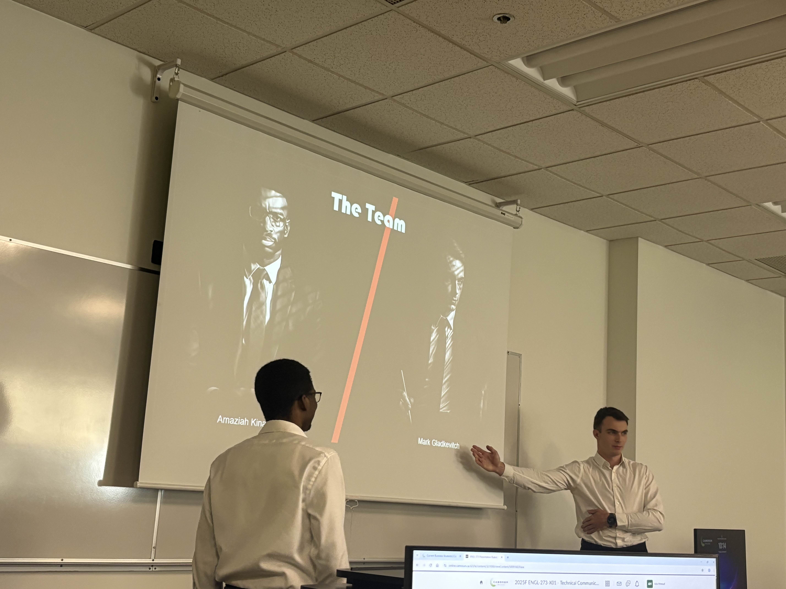
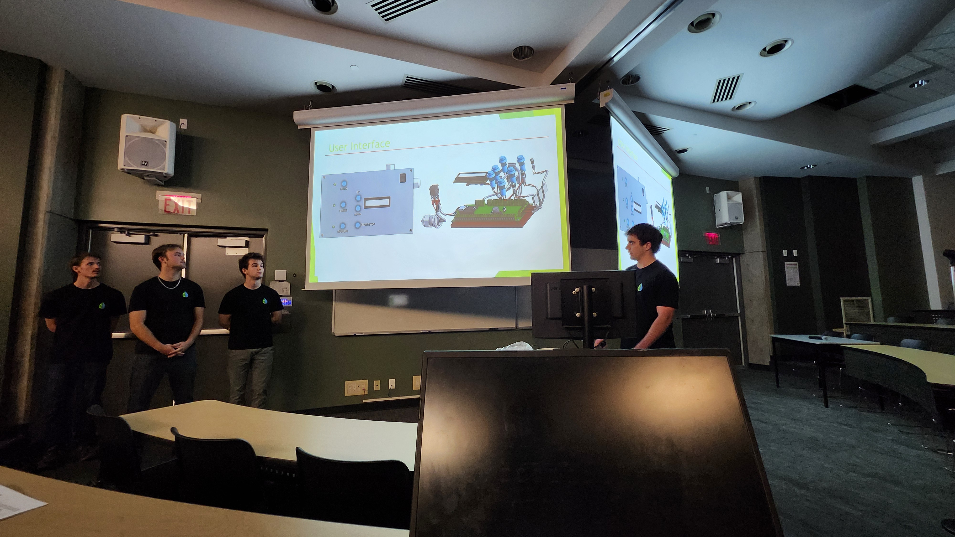
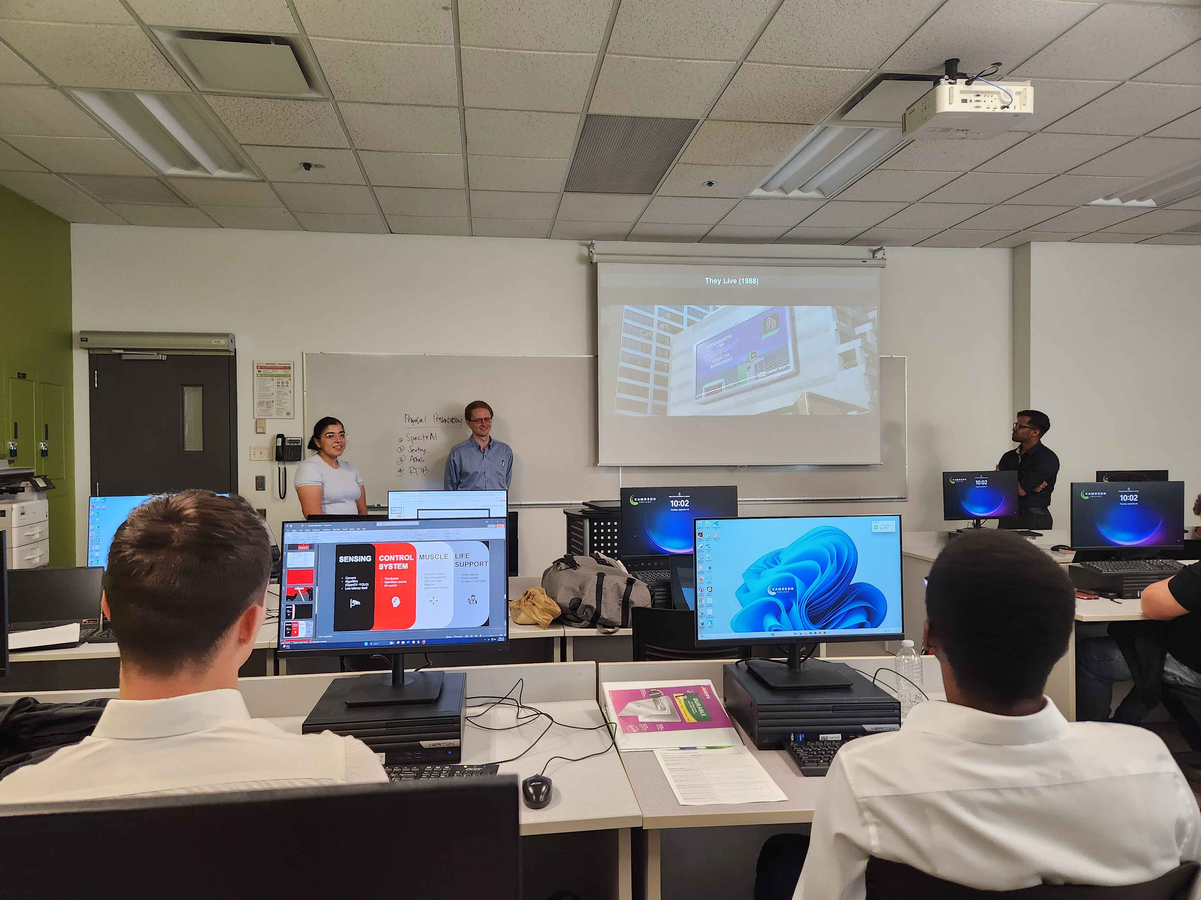
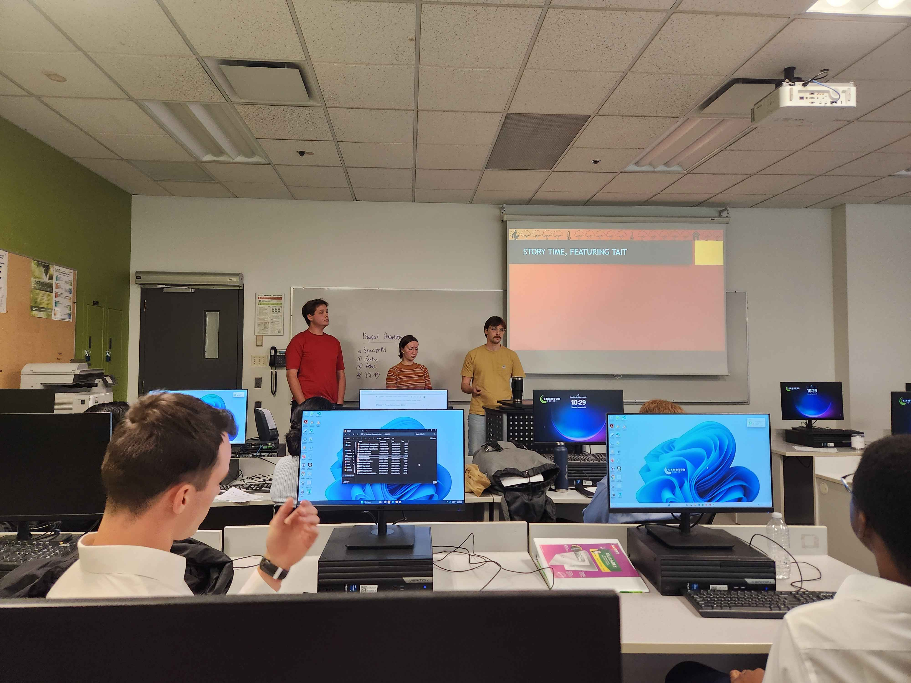
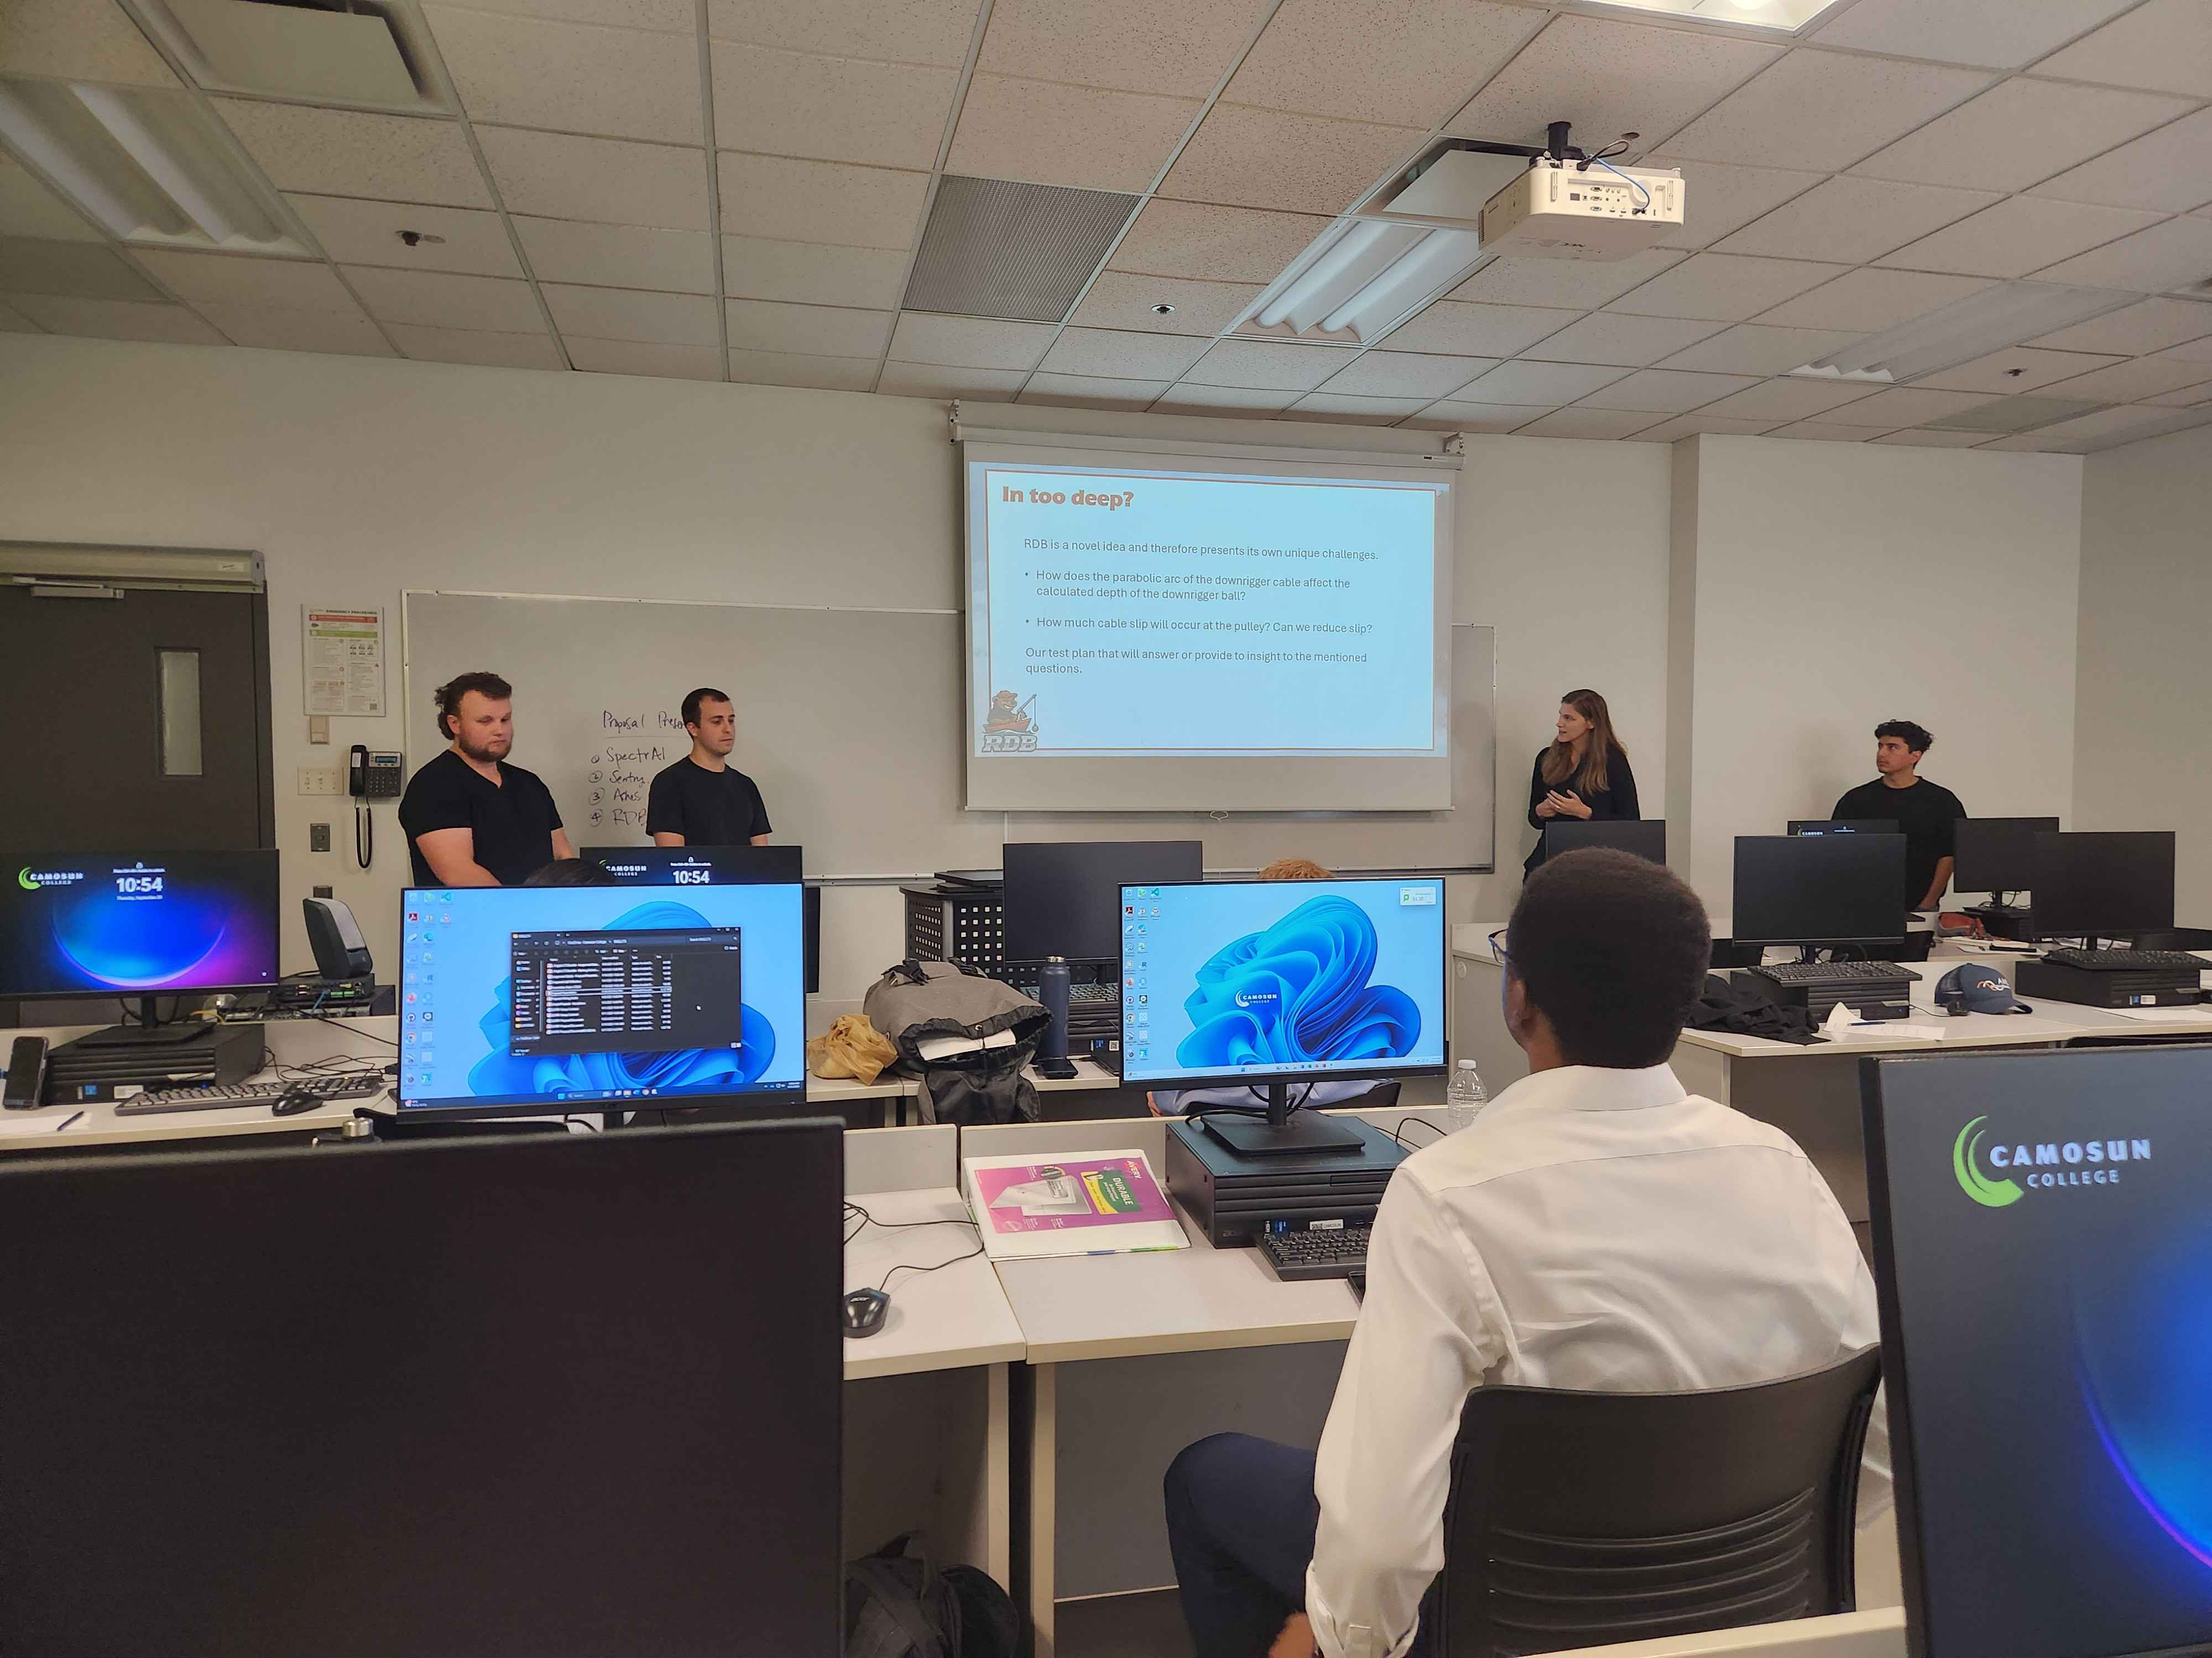
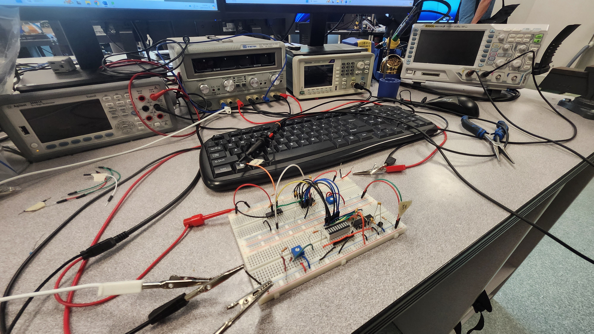
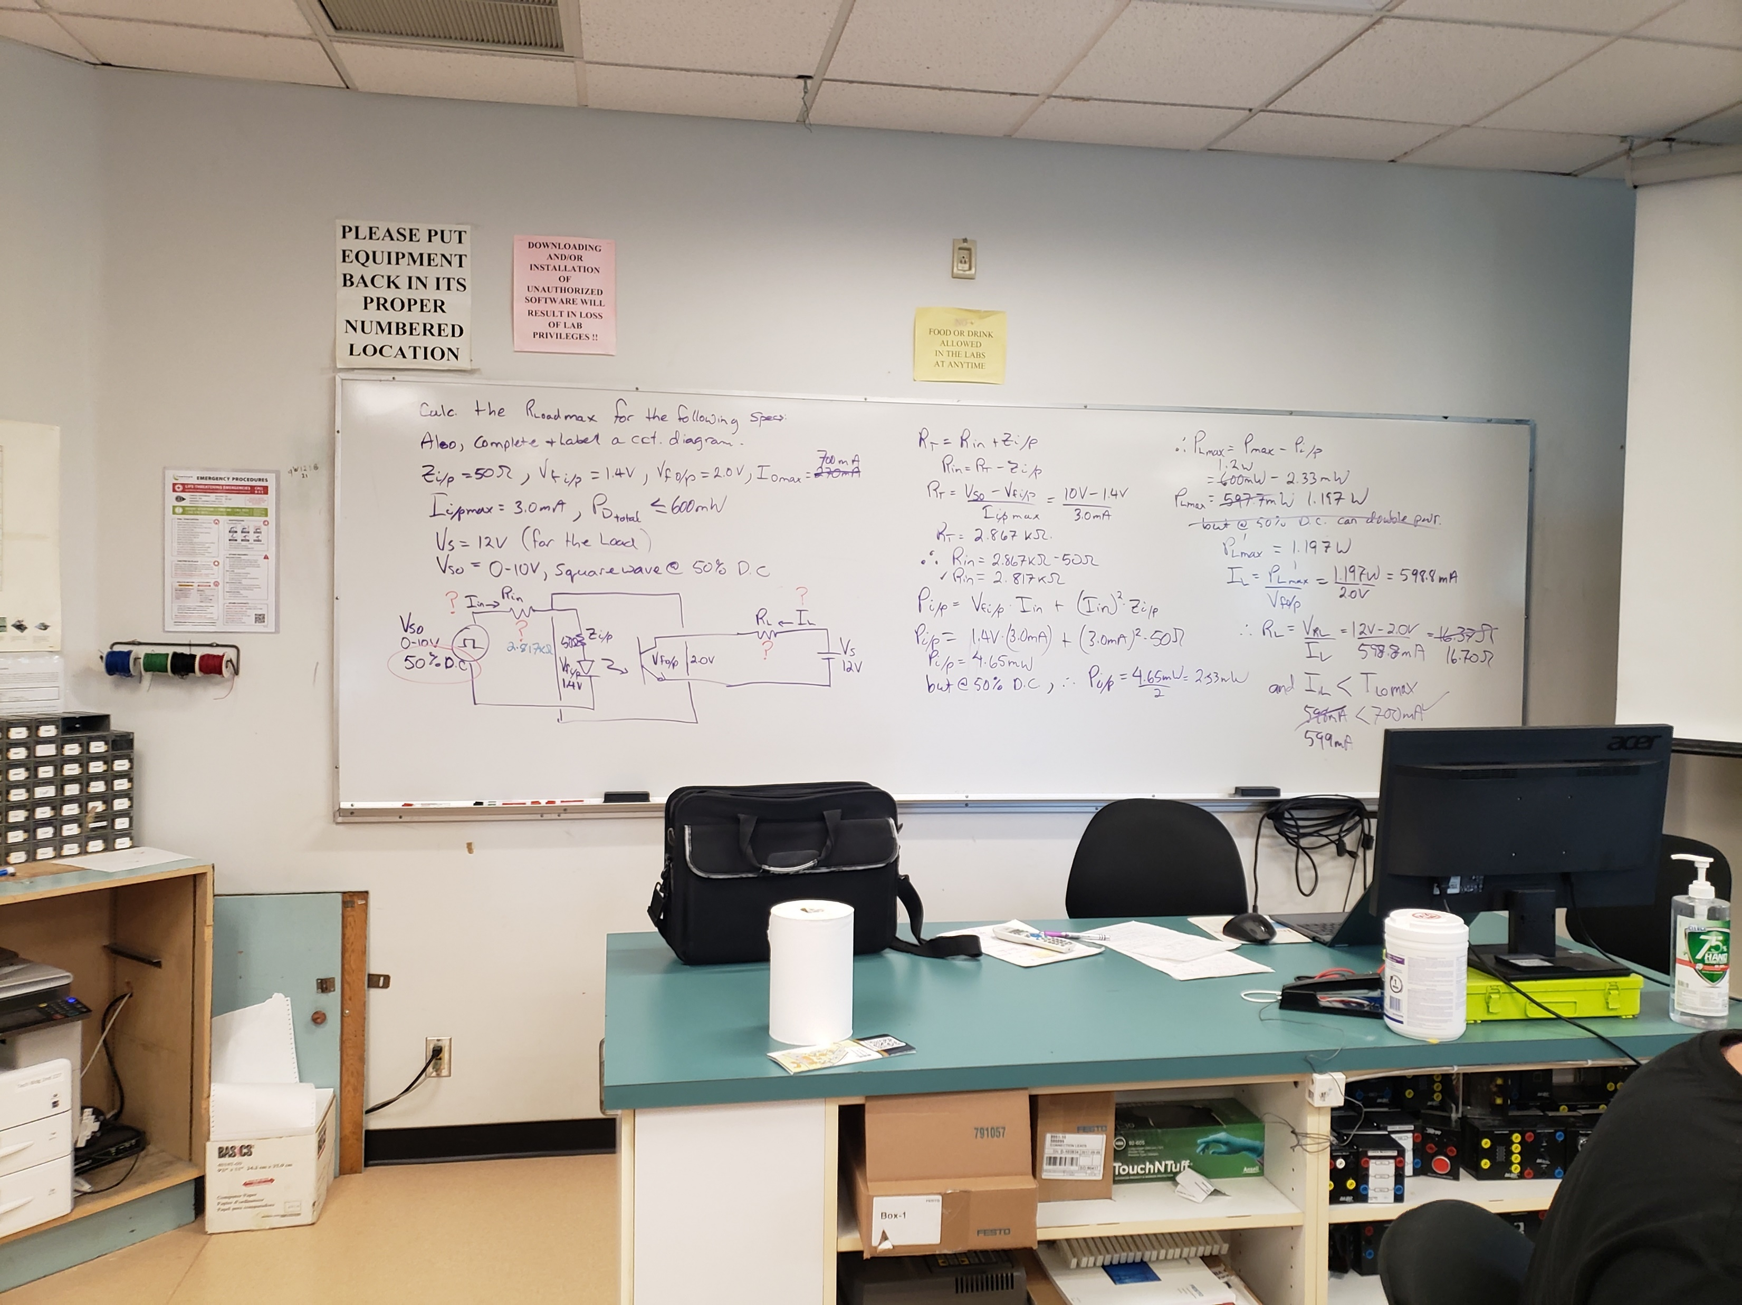
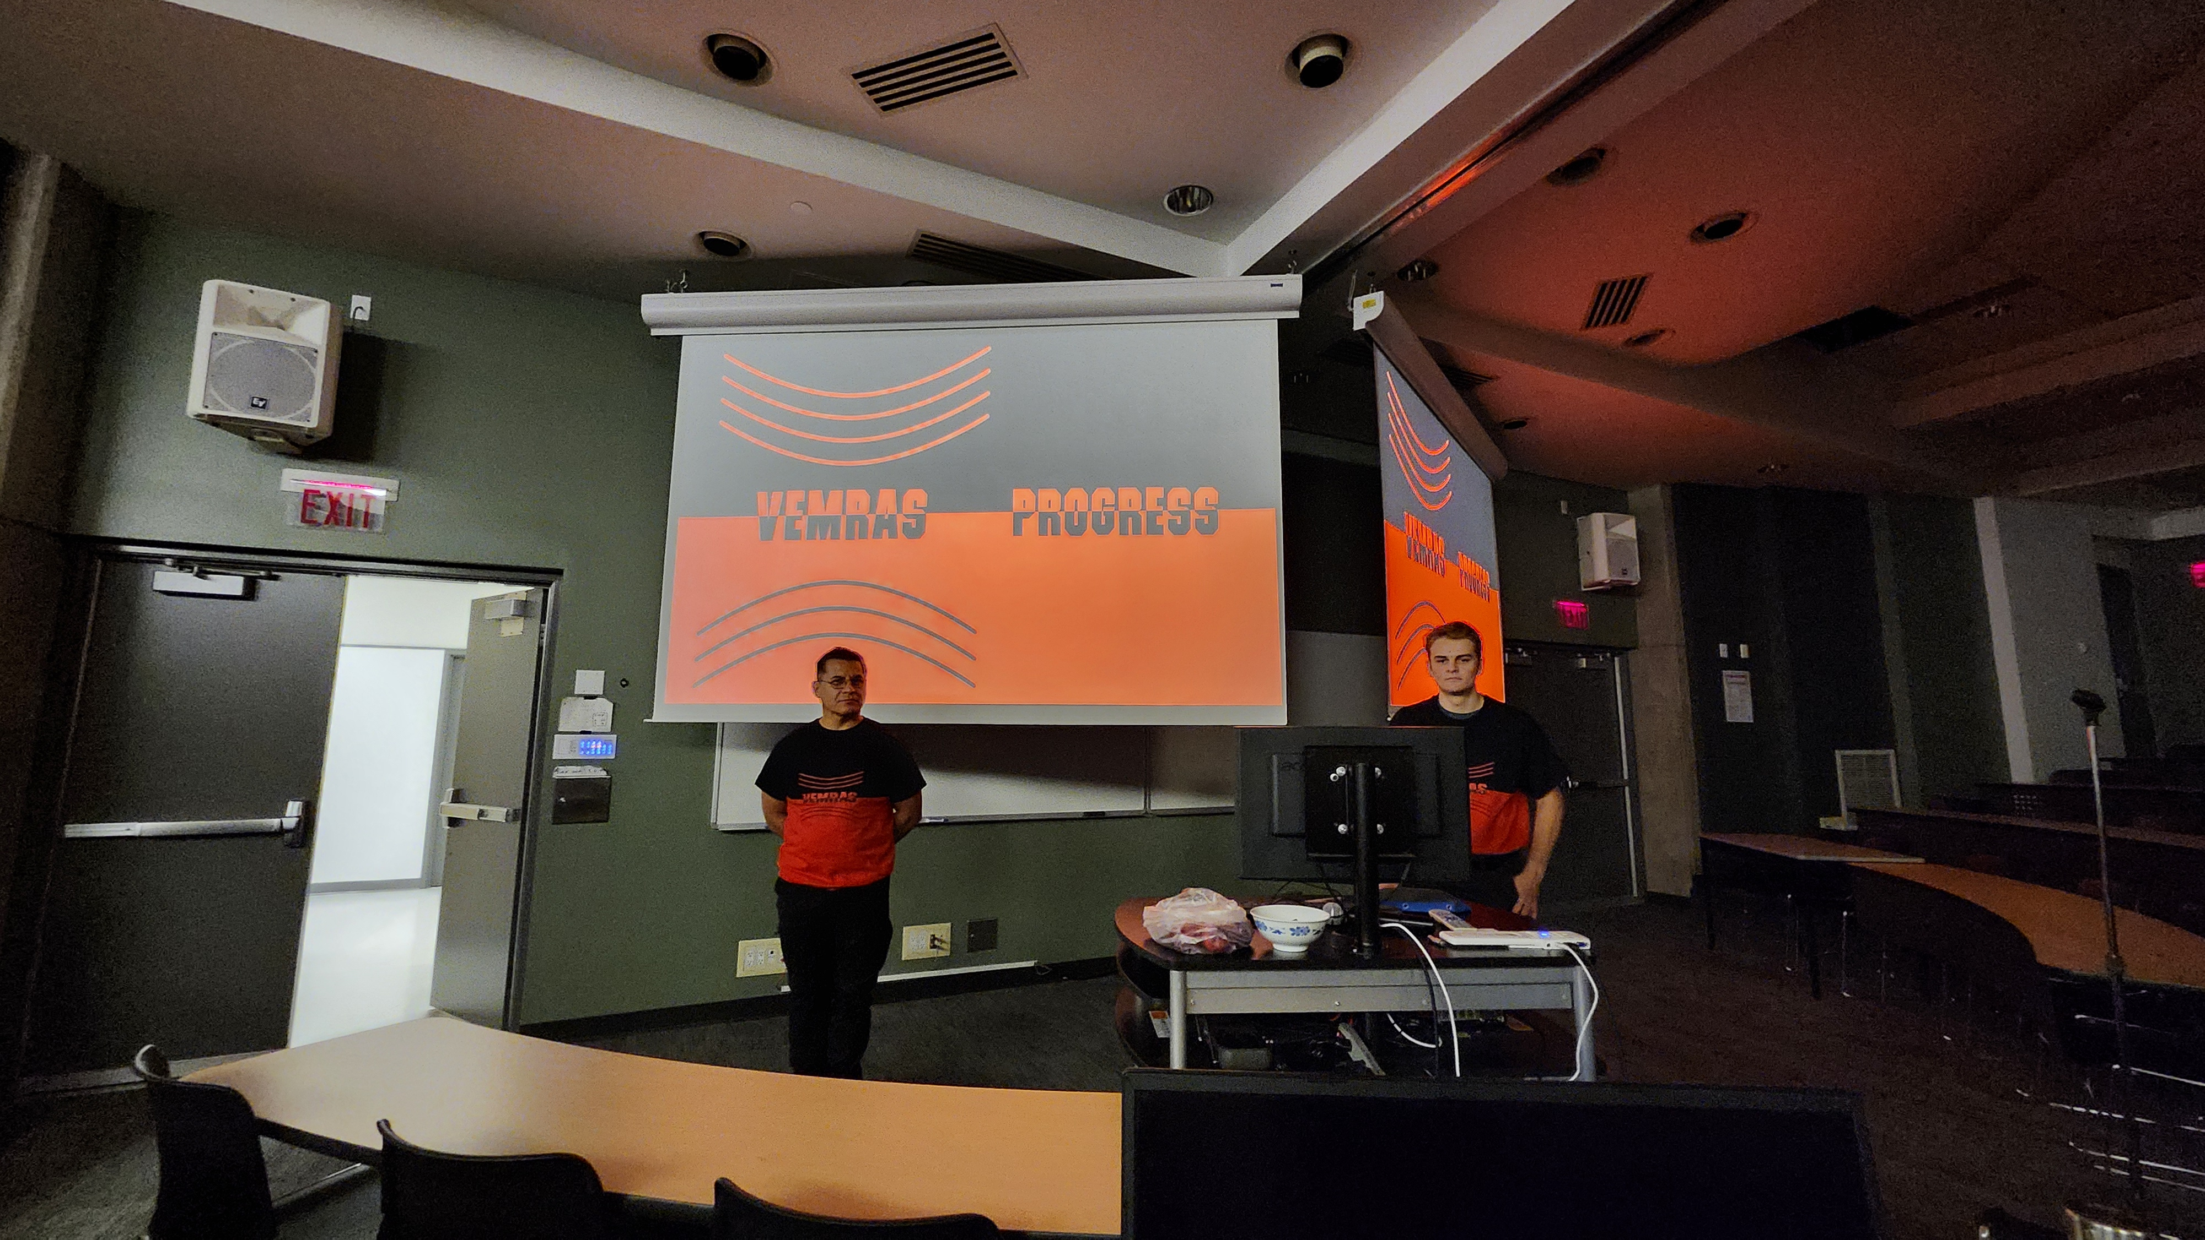
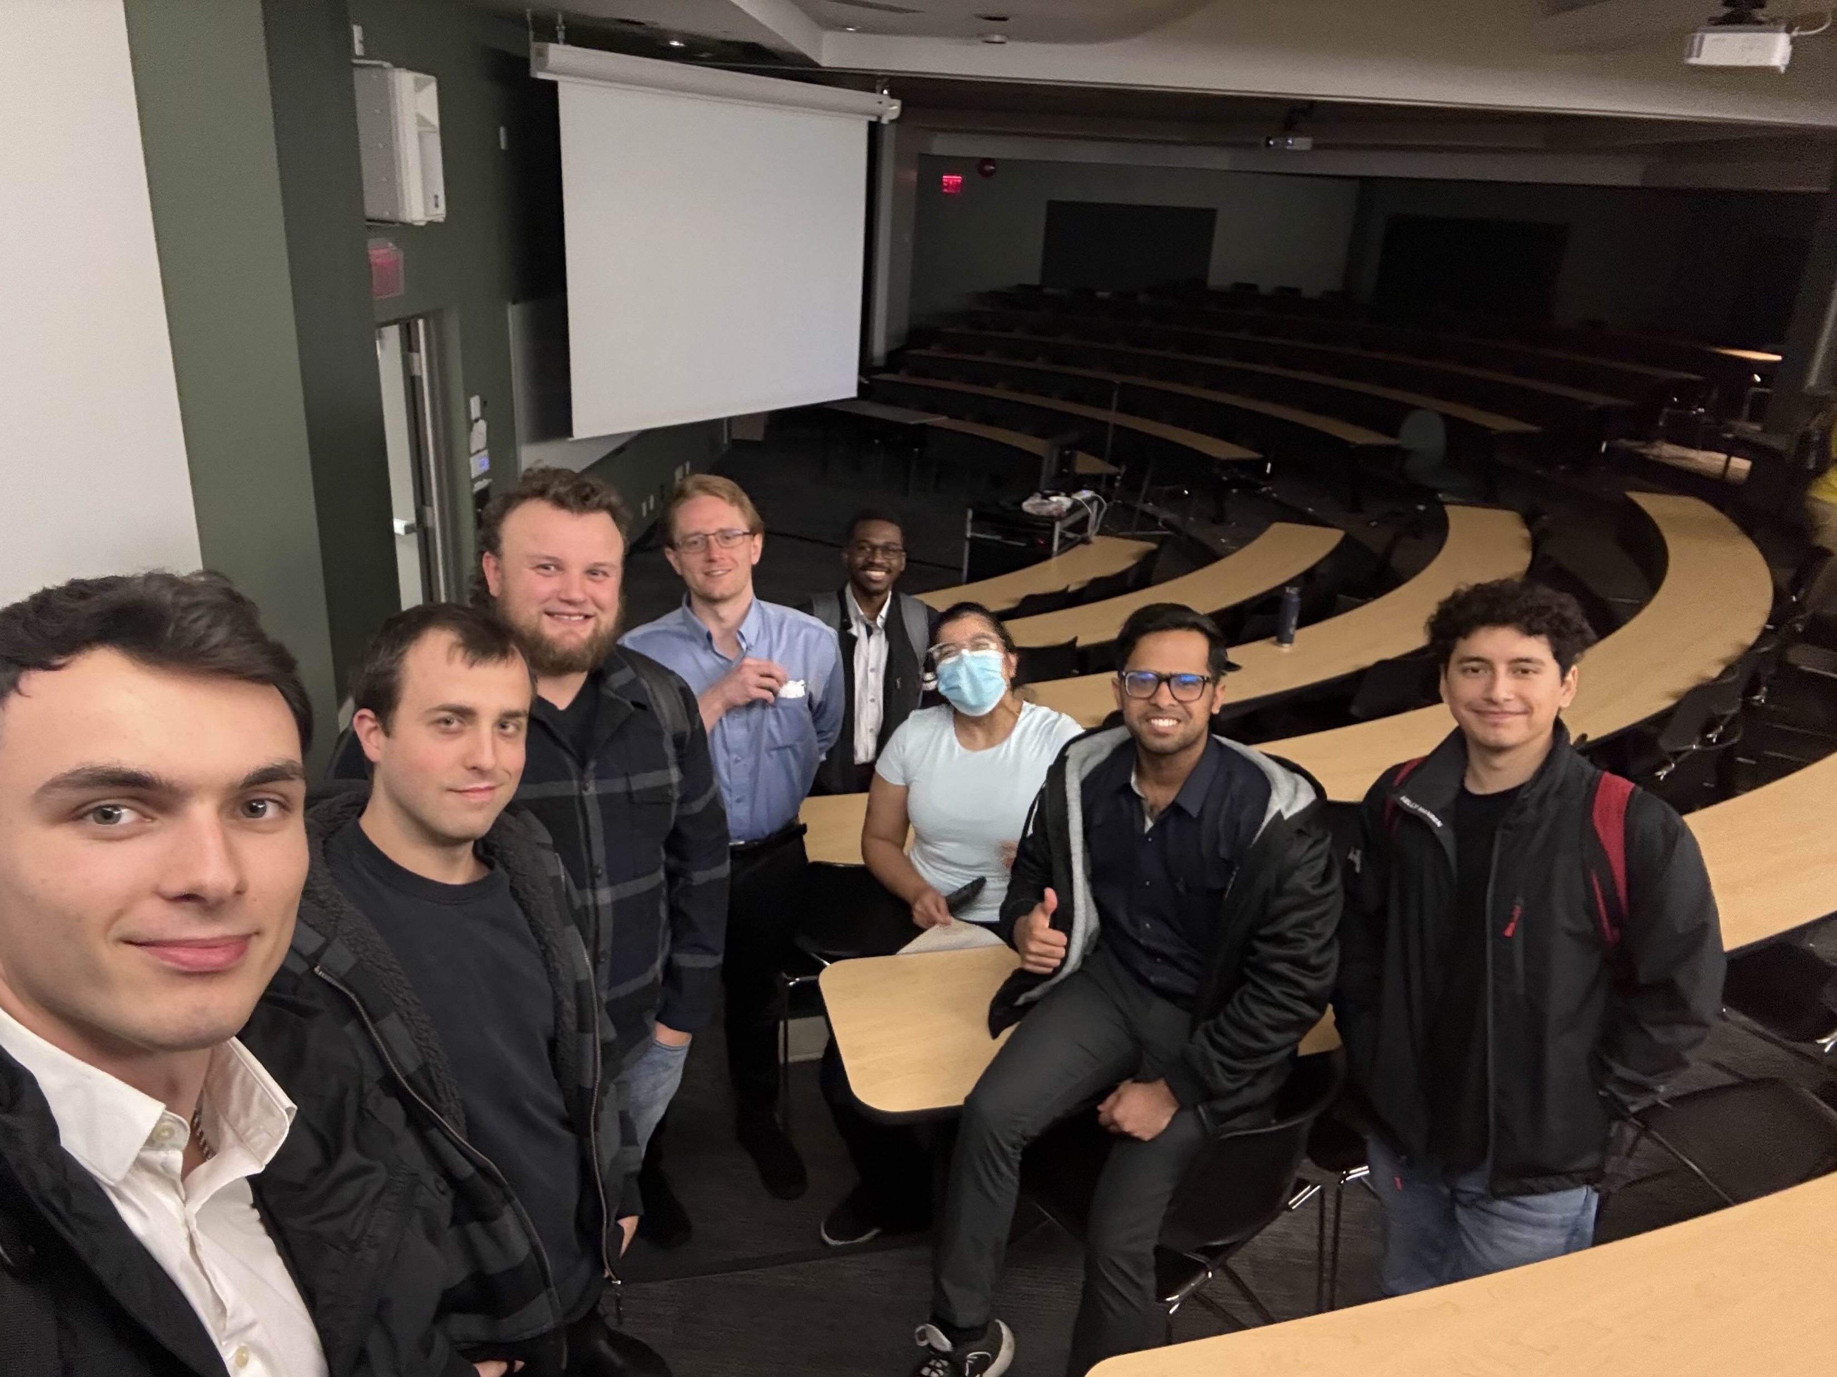
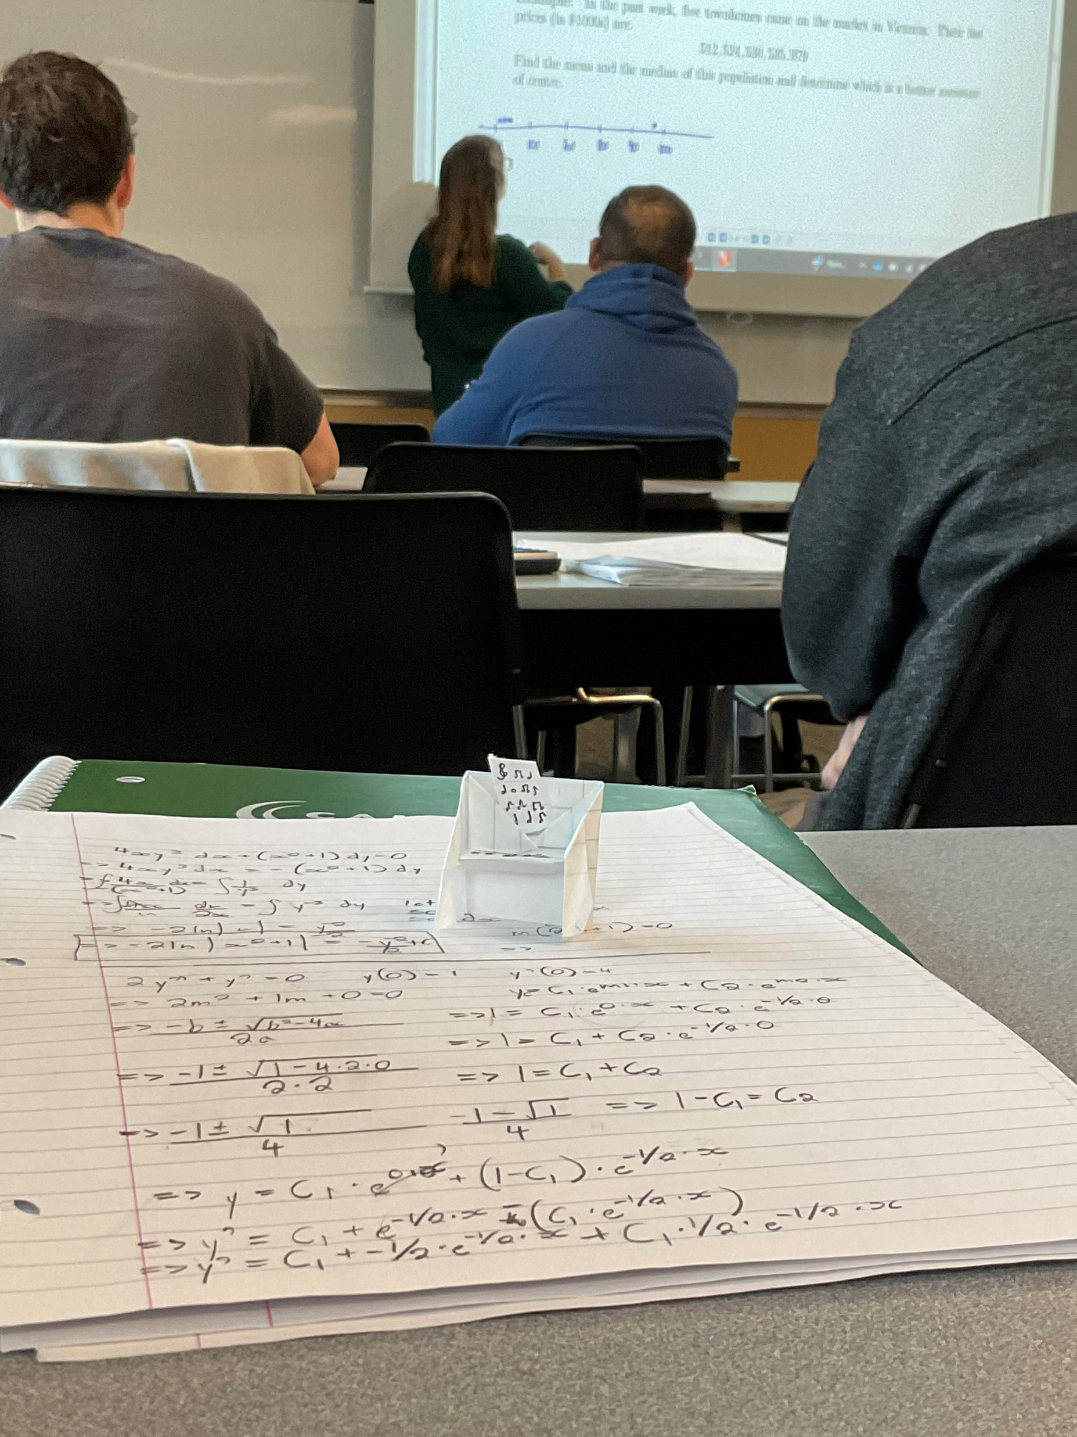
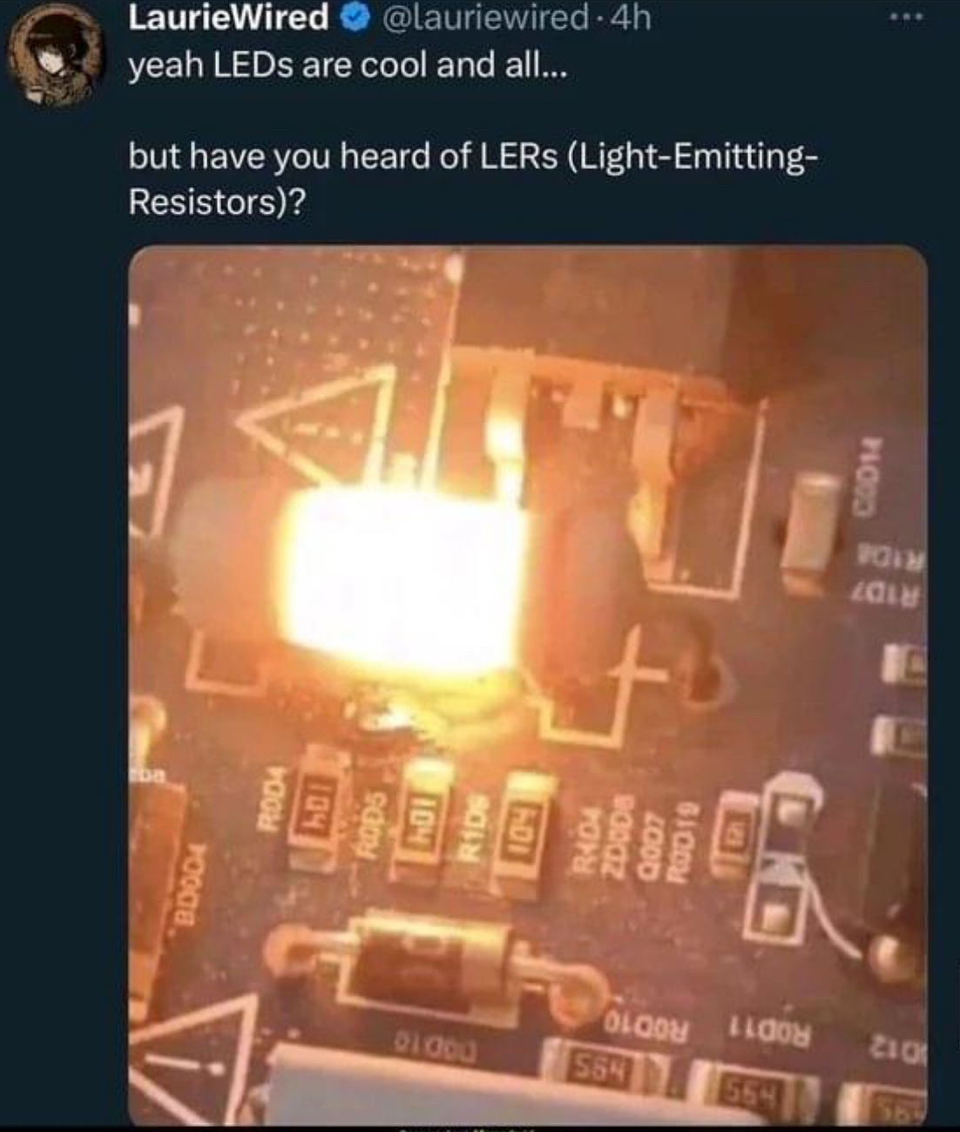
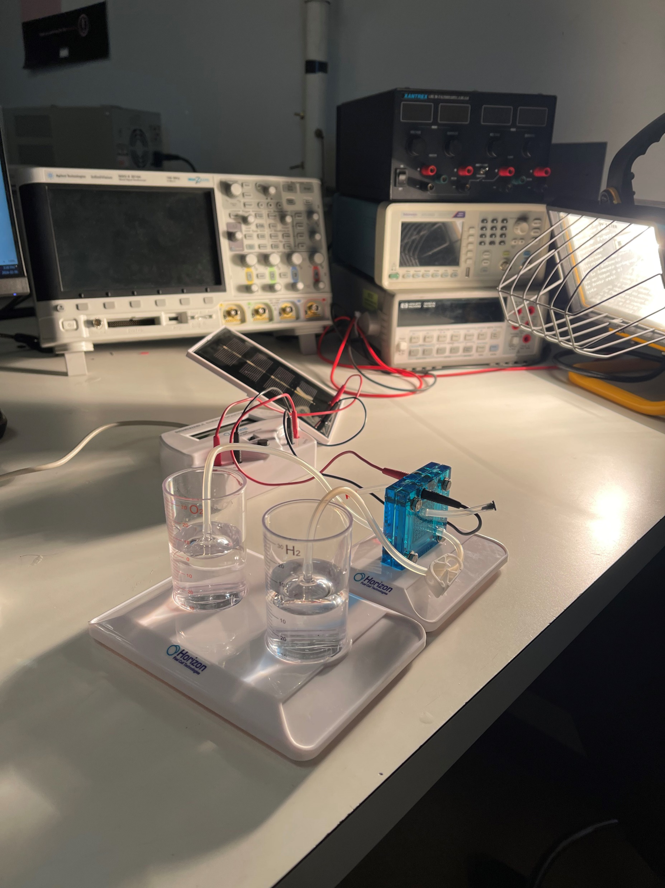
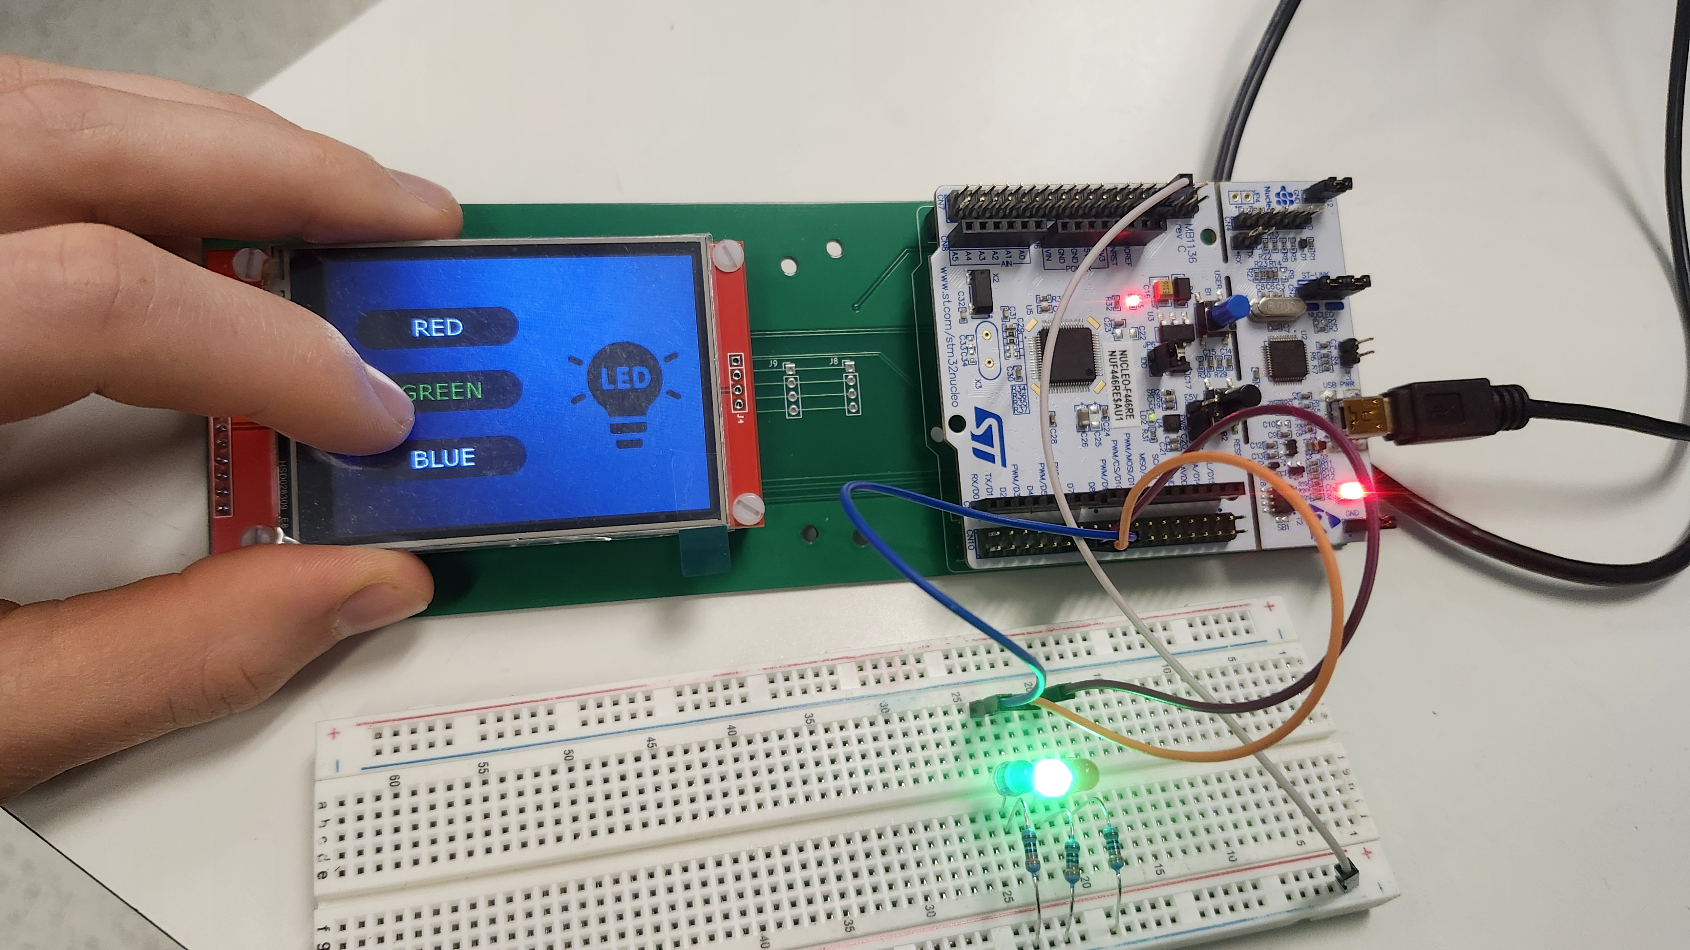

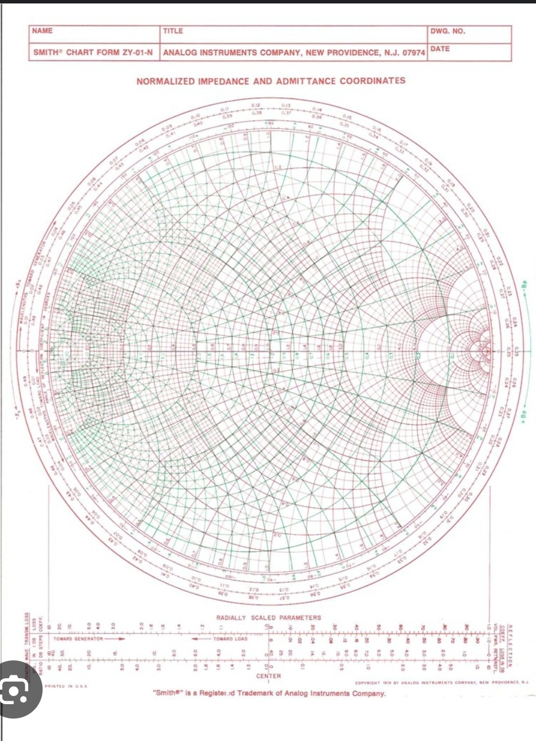
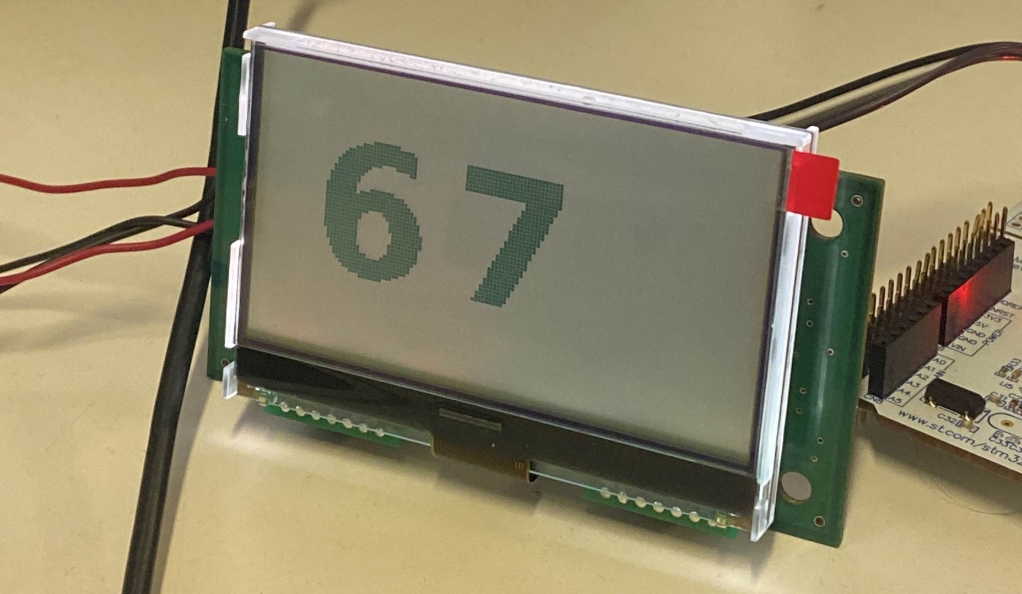
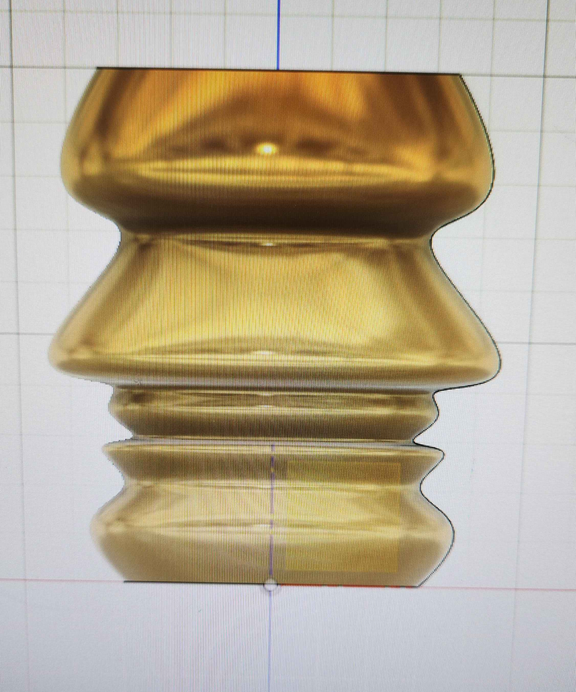

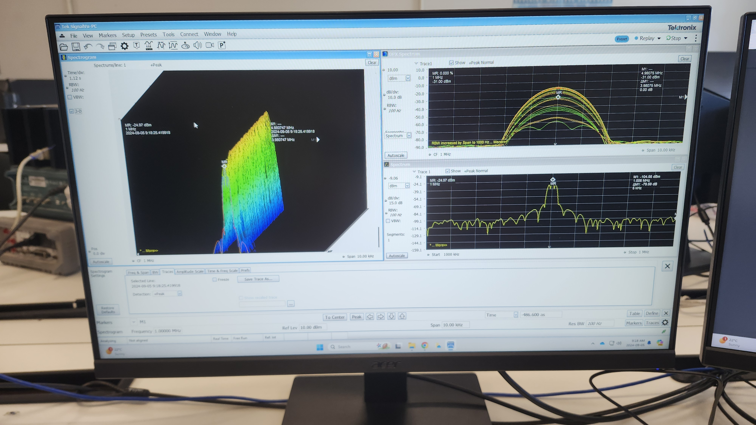
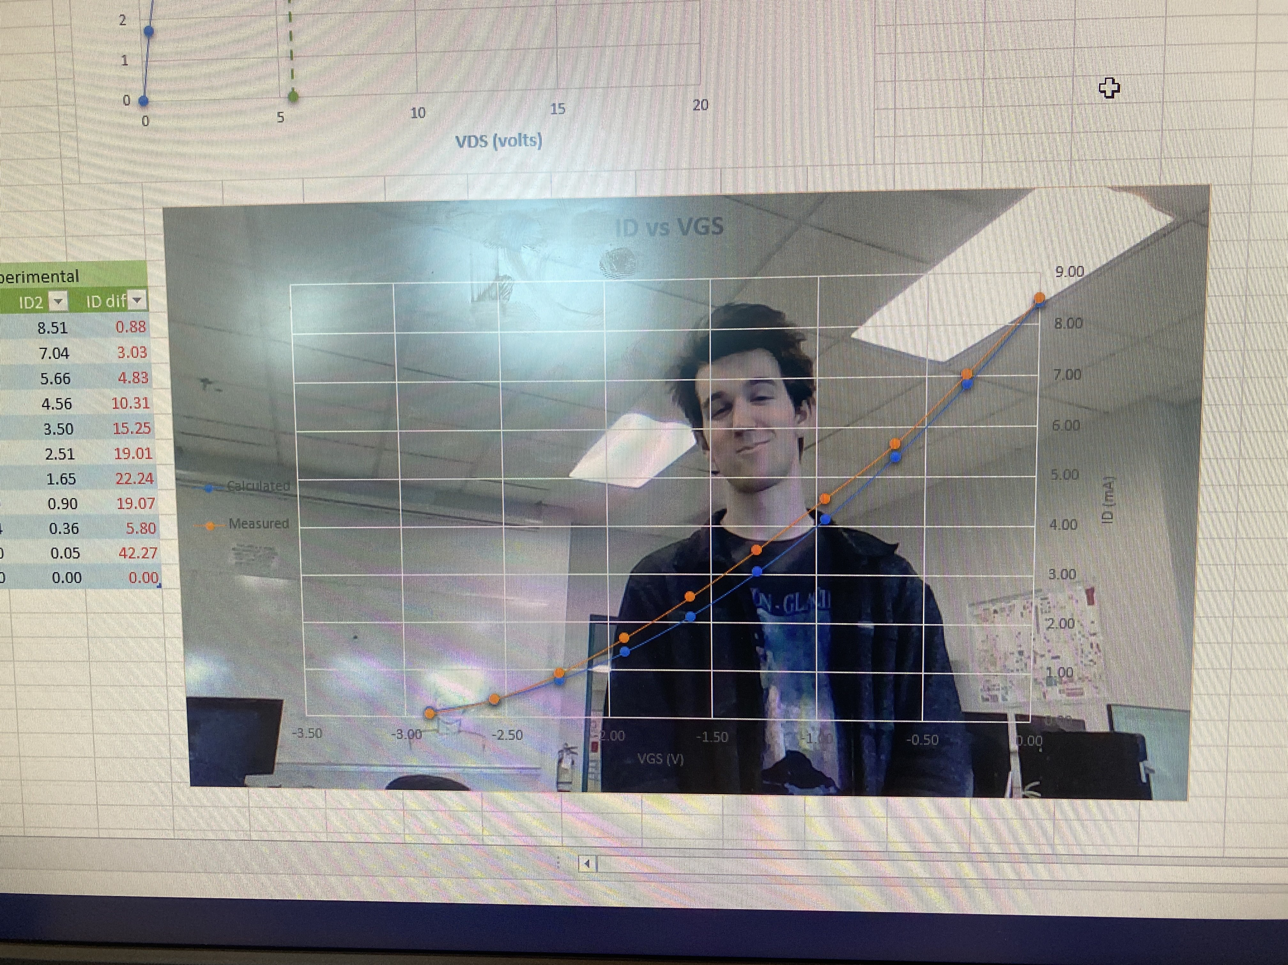
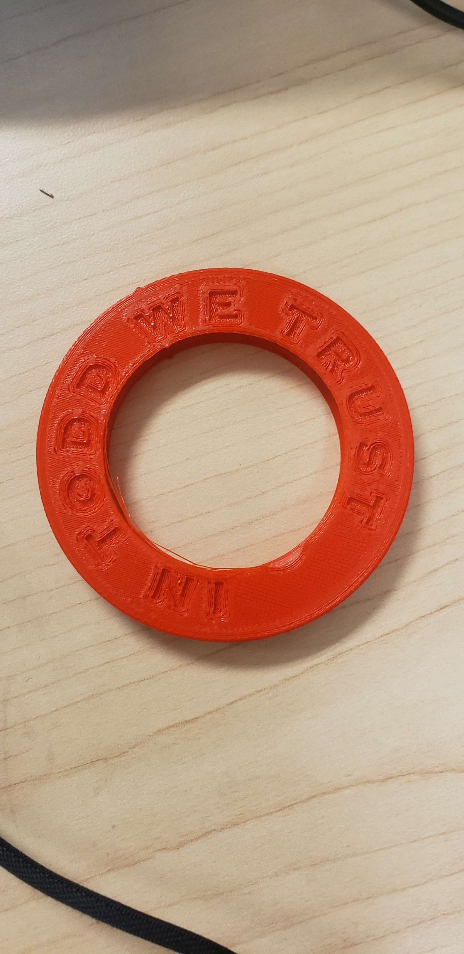
(Blown up PLC)
Notes:
1. Our journey – difficult - understatement
2. Brick walls
3. Each endured their own version
4. Worries, struggles, question why u here,
yet you chose to keep going
5. Desperate deadlines, comrades fall one by one
6. Not many made through
Every inch!!!!!
7. Every lab…………. Shaped ppl
8.Our hard work, testament
And truth is……
9. Not everyone made it here
Earned place, earned moment
Thank you
God bless

Slide 36
+ + + + +
+ + + + +
Your property’s safety is our priority

