Slide 1

SENTRY

Slide 2
SENTRY

Slide 3
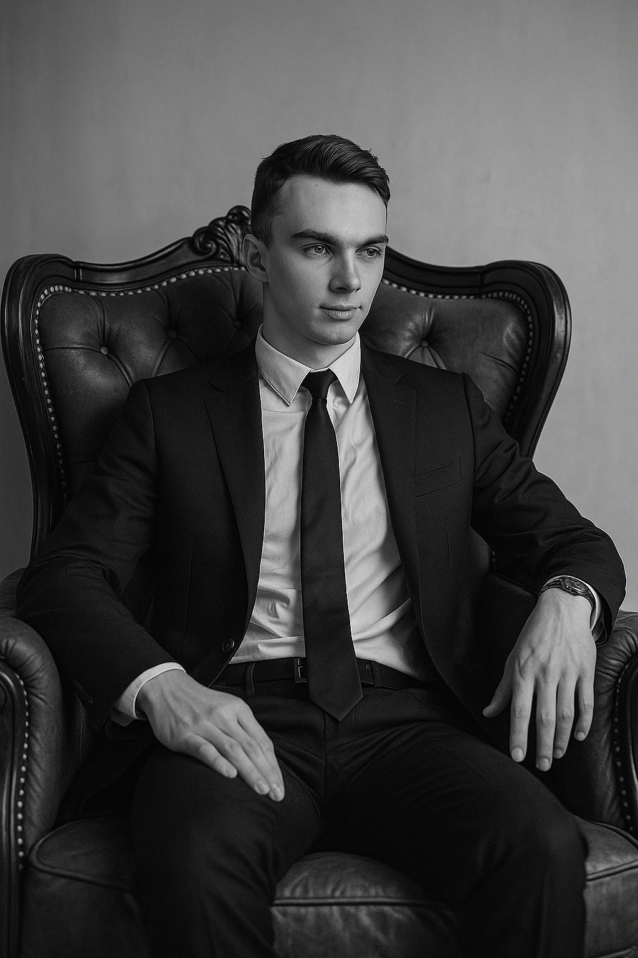
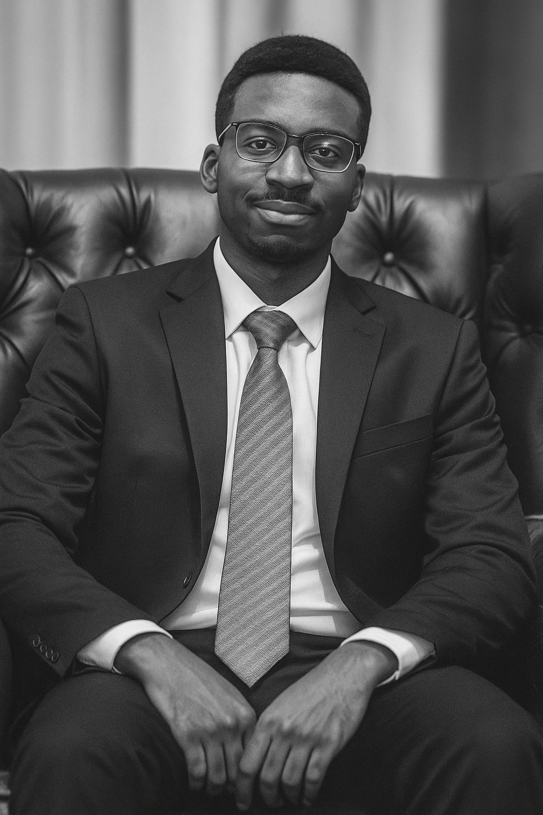
The Team

Slide 4
Timeline
PCB components Ordered
Emotional Damage
3D model start
Emotional Damage
Parts ordered
PCB design start
PCB Ordered
PCB arrived
Week 2
Week 3
Week 4
Week 5
Week 6
Week 7
Week 8
Week 9
Software vision start
3D model complete
Software research
Parts arrived
Software recognising targets
Serial communication R&D

Slide 5
Theory.
1.Detect
+ + + + + + +
+ + + + + + +
+ + + + + + +
+ + + + + + +
2.Delete

Slide 6
Theory.
+ + + + + + +
+ + + + + + +
+ + + + + + +
+ + + + + + +
1.Detect
2.Delete

Slide 7
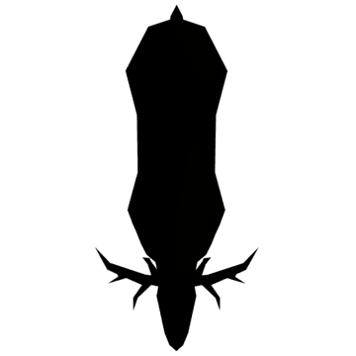
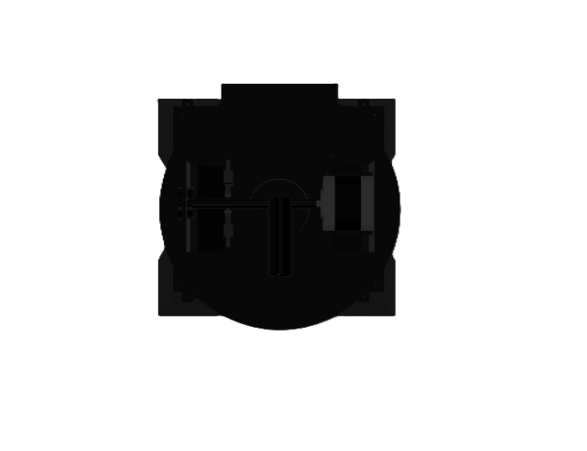
Hardware
+ + + + + + +
+ + + + + + +
+ + + + + + +
+ + + + + + +

Slide 8
Hardware
+ + + + + + +
+ + + + + + +
+ + + + + + +
+ + + + + + +

Slide 9
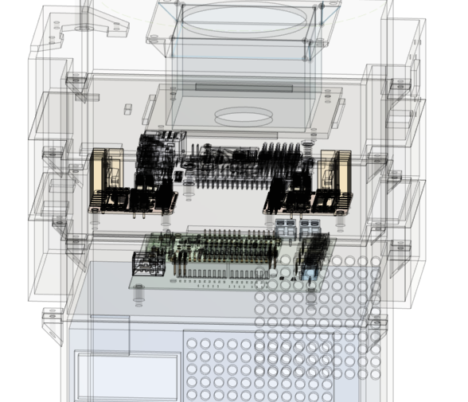
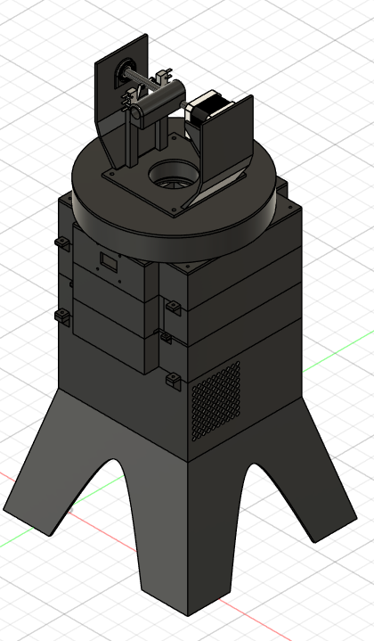

Slide 10




ENERGY
CONTROL SYSTEM
MUSCLE
SENSING

Slide 11
SENSING
CONTROL SYSTEM
MUSCLE
ENERGY

Slide 12
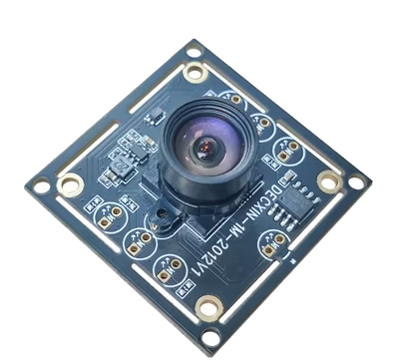
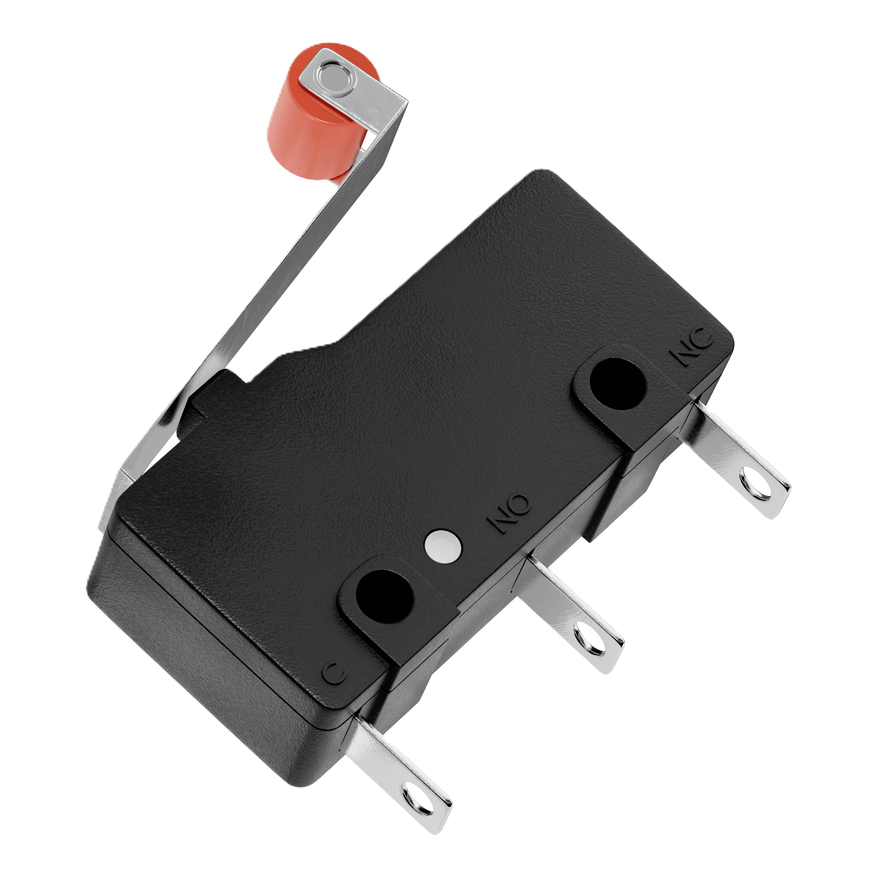
CONTROL SYSTEM
SENSING
CONTROL SYSTEM
MUSCLE
LIFE SUPPORT
Limit switch
OV9732 Camera
100-degree field of view (FOV)
USB type A connector
Capable of 30fps at 1280x720p resolution
Night vision capable with IR CUT filter
Sets turning distance boundaries
Sets homepoint

Slide 13
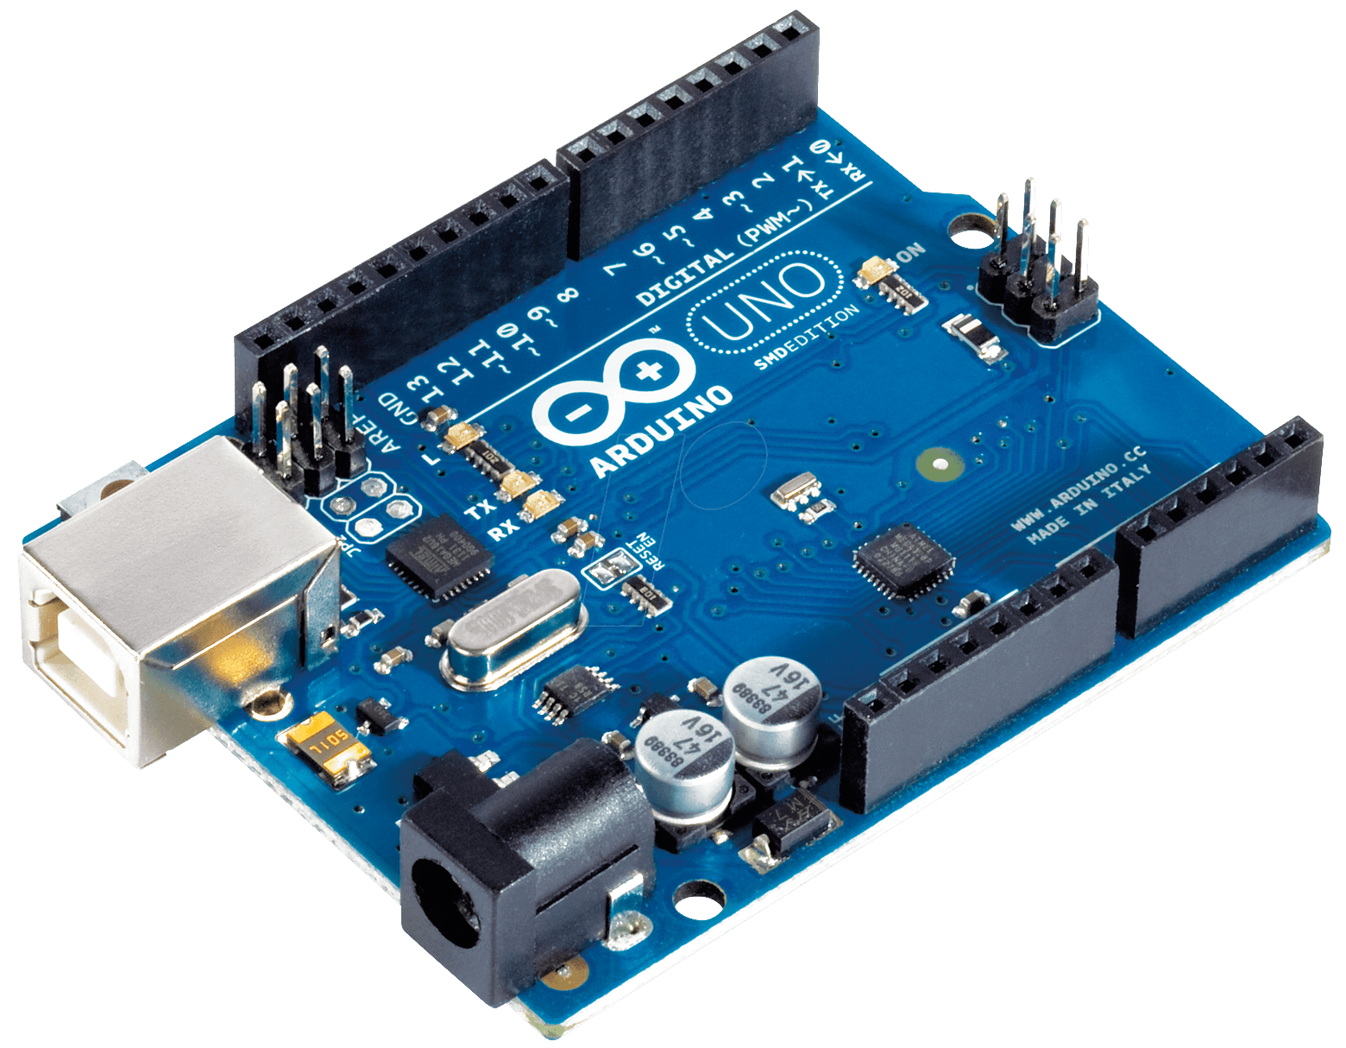

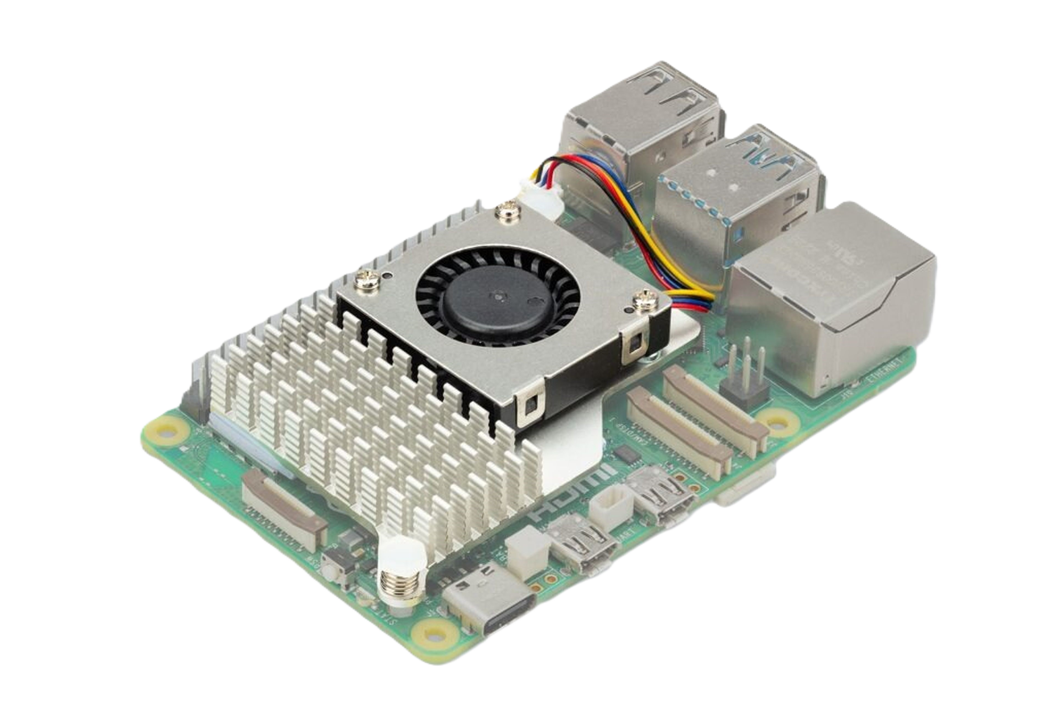
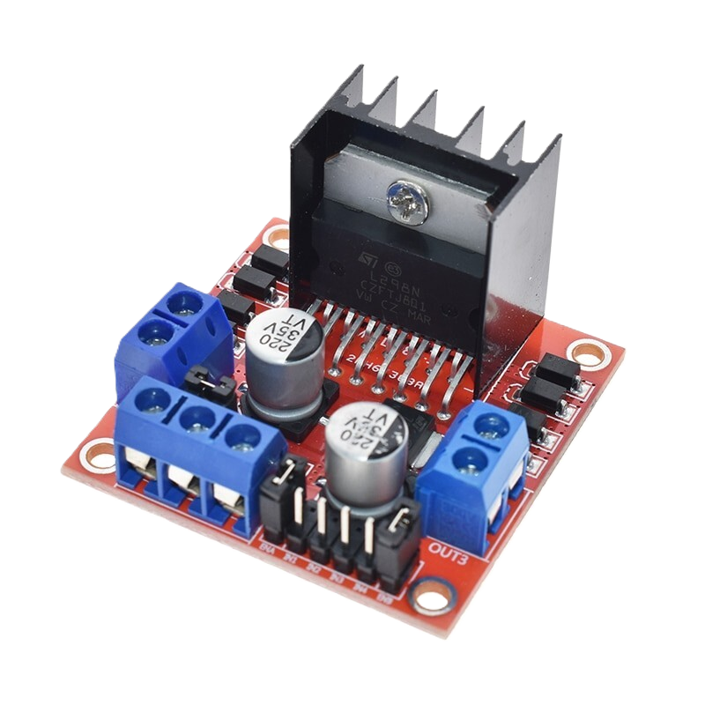
CONTROL SYSTEM
Arduino
MUSCLE
SENSING
CONTROL SYSTEM
MUSCLE
LIFE SUPPORT
Plenty of experience
Great for motors, sensors, deterrents
100-degree field of view (FOV)
Compact
Capable of 30fps at 1280x720p resolution
Night vision capable with IR CUT filter (IR LED needed)
Raspberry Pi
Motor Control Module
Powerful/Fast chipset (2.4Ghz)
Easy to operate and program
Wide array of available connections
Available in backroom
Can handle high currents (over 1.5A)

Slide 14
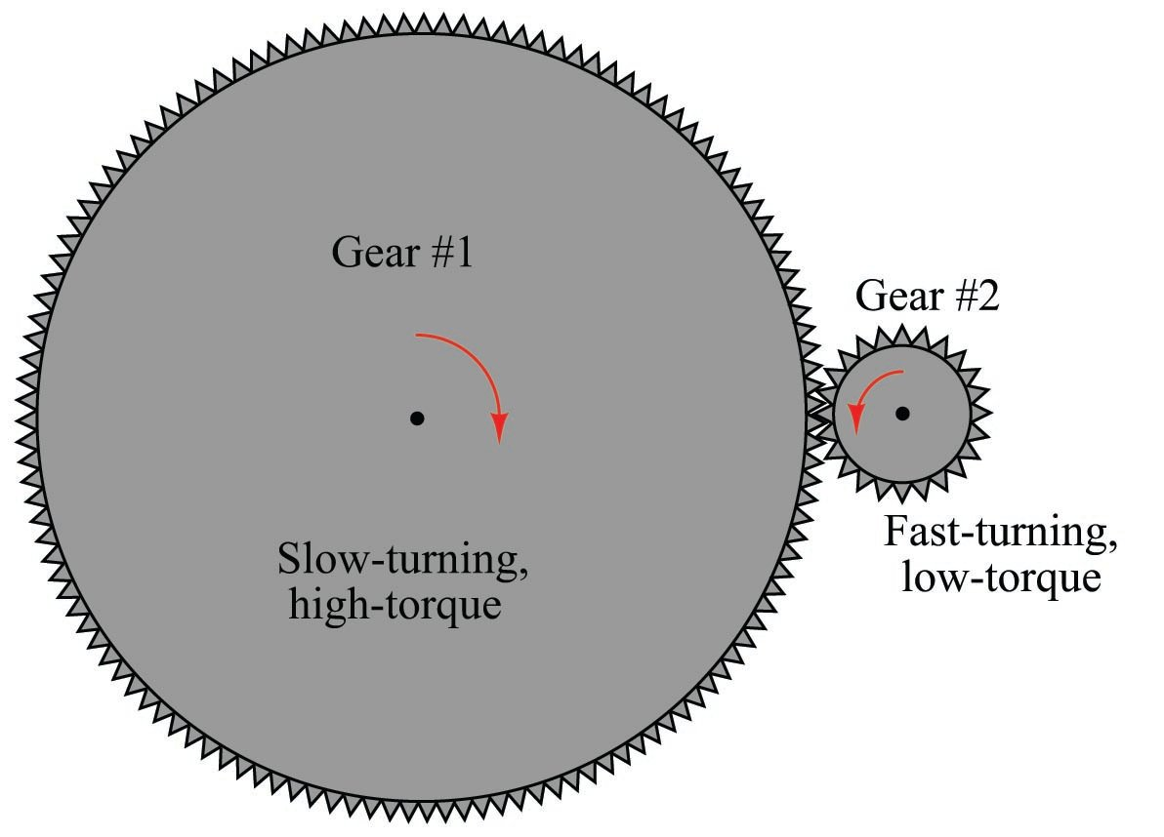
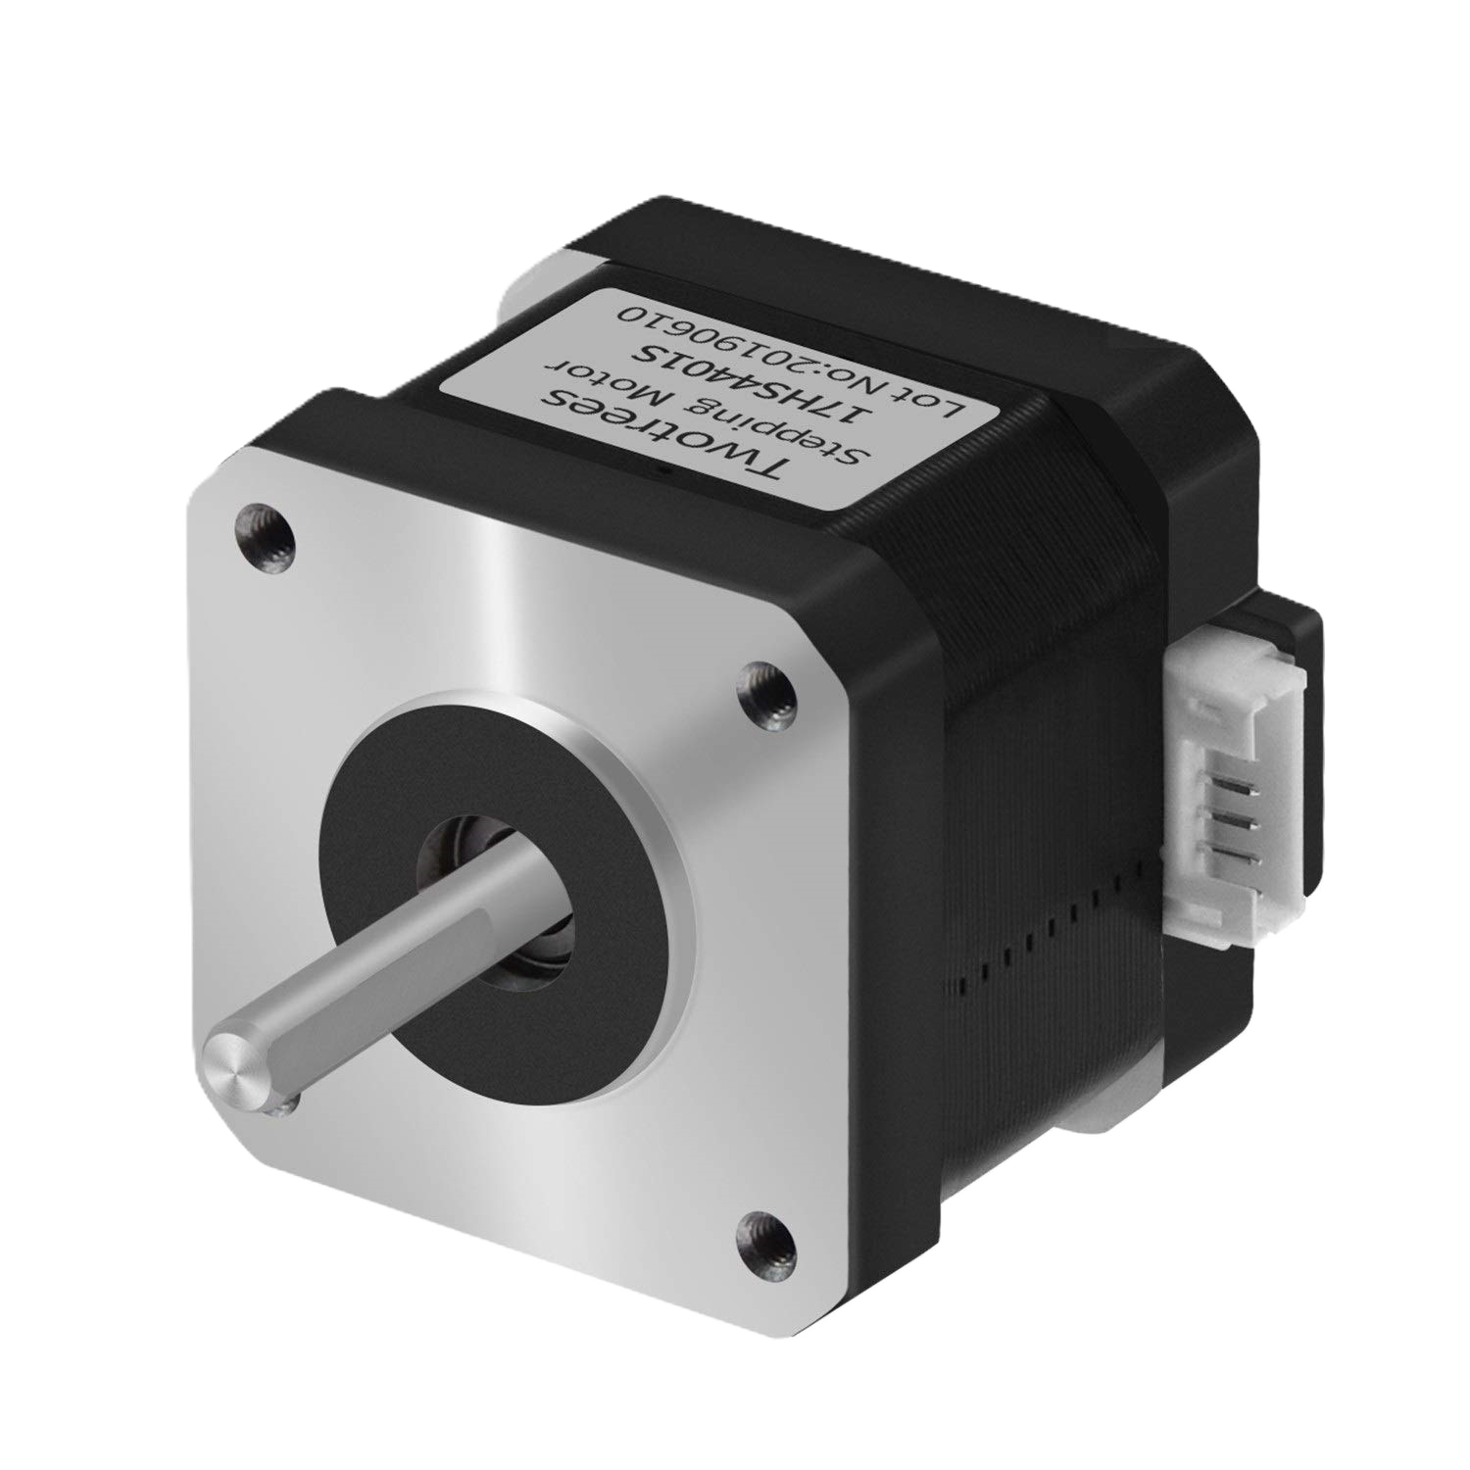
CONTROL SYSTEM
MUSCLE
ENERGY
SENSING
CONTROL SYSTEM
MUSCLE
LIFE SUPPORT
10:1 Gears
100-degree field of view (FOV)
Compact
Capable of 30fps at 1280x720p resolution
Night vision capable with IR CUT filter (IR LED needed)
NEMA 17 Stepper Motor
High speed (1200rpm)
Precise
Cheap(er)
Sacrificing speed for higher torque
Can turn more weight

Slide 15
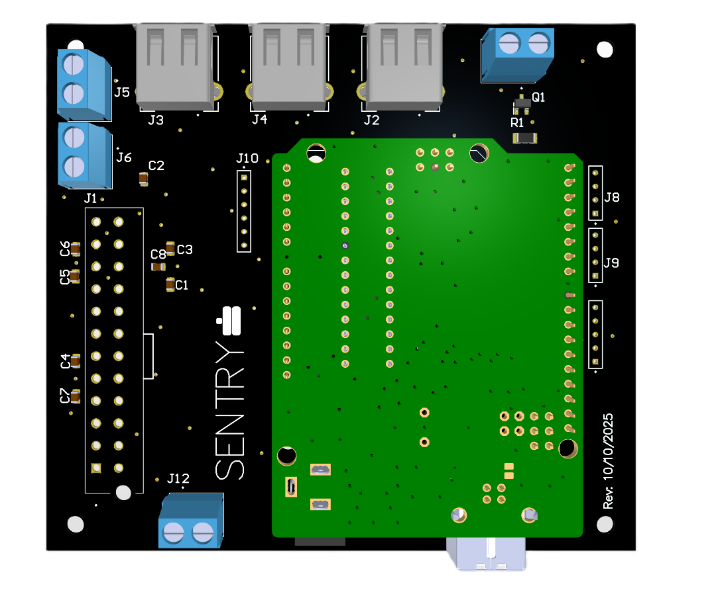
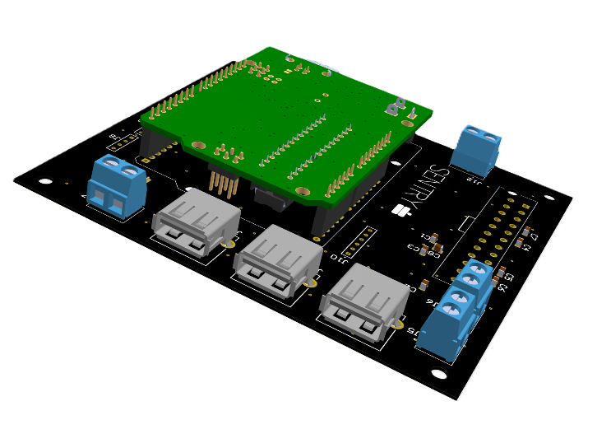
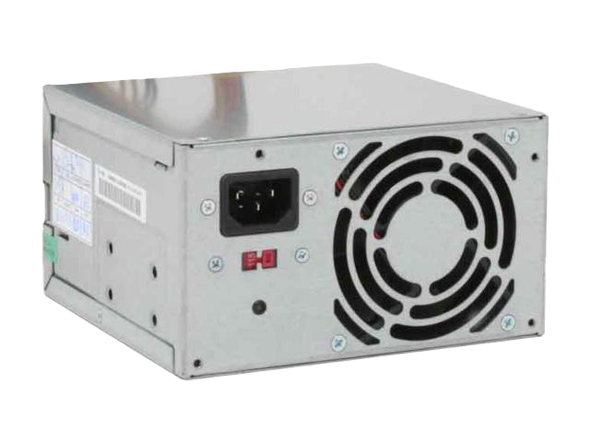
CONTROL SYSTEM
ENERGY MANAGEMANT
MUSCLE
SENSING
CONTROL SYSTEM
MUSCLE
LIFE SUPPORT
100-degree field of view (FOV)
Compact
Capable of 30fps at 1280x720p resolution
Night vision capable with IR CUT filter (IR LED needed)
All power cords from devices merged into one wall outlet cord
Arduino mount + extra free I/O pins
Has many different available voltages (3.3V, 5V, 12V)
High current availability
Free

Slide 16
ENERGY MANAGEMANT
CONTROL SYSTEM
MUSCLE
Extra USB type A
SENSING
CONTROL SYSTEM
MUSCLE
LIFE SUPPORT
Screw terminals
100-degree field of view (FOV)
Compact
Capable of 30fps at 1280x720p resolution
Night vision capable with IR CUT filter (IR LED needed)
Extra I/O pins
PSU connector
Mounted Arduino Uno
Has many different available voltages (3.3V, 5V, 12V)
High current availability
Free
All power cords from devices merged into one wall outlet cord
Arduino mount + extra free I/O pins

Slide 17


SENSING
CONTROL SYSTEM
MUSCLE
ENERGY
DETERRENTS☺

Slide 18
ENERGY
CONTROL SYSTEM
MUSCLE
SENSING
DETERRENTS☺

Slide 19
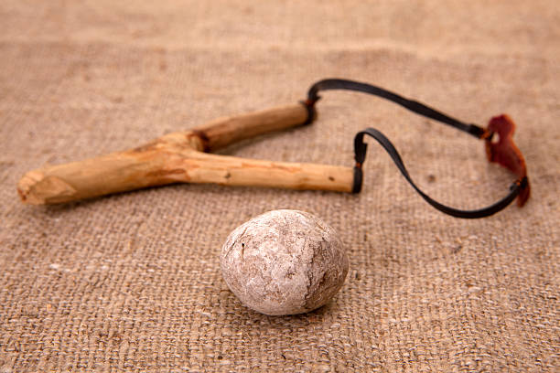
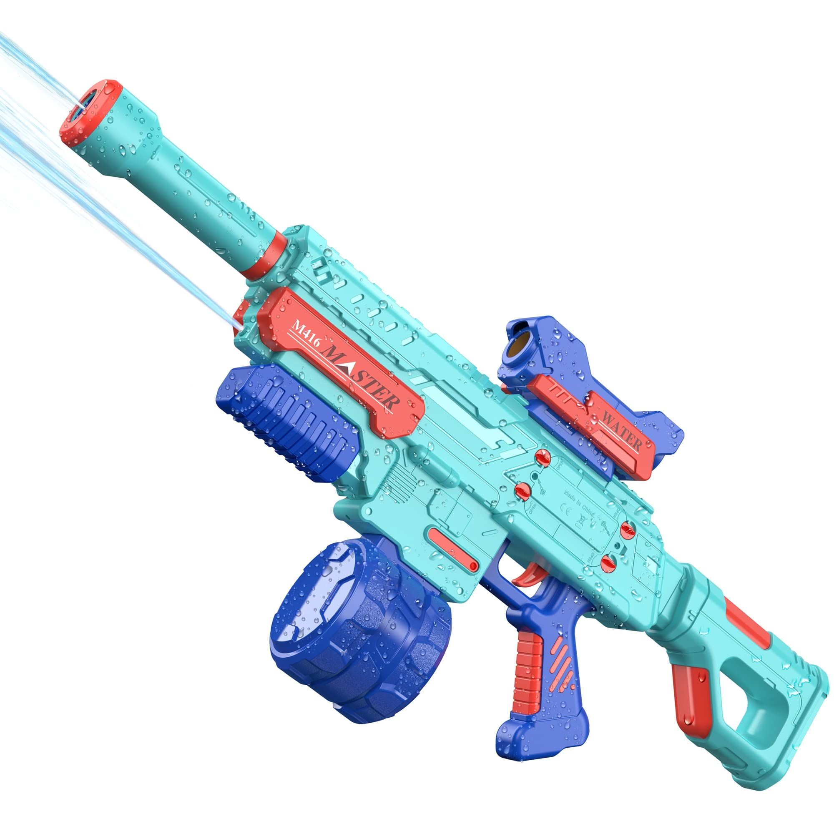
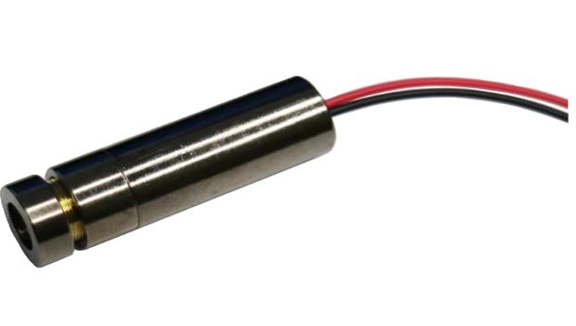
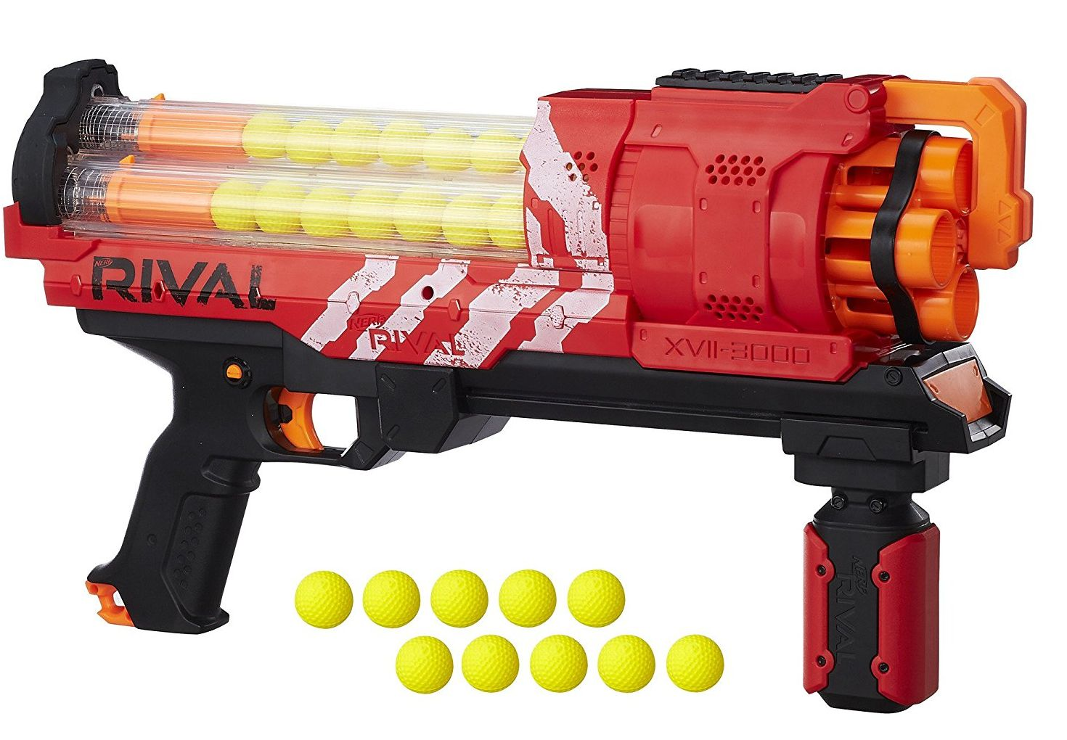
ENERGY
(AUG A2)
CONTROL SYSTEM
DETERRENTS☺
SENSING
(Bushmaster XM-15)
5mW Green Laser
(FN SCAR-H MK17)
Aiming for sub 10 MOA
(Minute Of Angle)
MUSCLE

Slide 20
SOFTWARE
+ + + + + + +
+ + + + + + +
+ + + + + + +
+ + + + + + +
Notes:
Right, so for software!

Slide 21
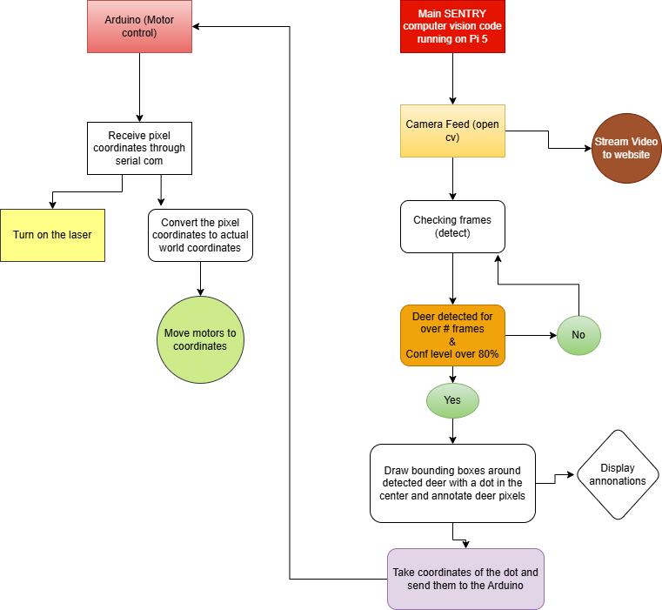
How is it going to work?
Notes:
We have programmed our raspberry pi5 to use a camera to detect and track deer. This flow chart shows how our program works. Basically, the program opens a camera feed and checks every frame for a detection and if a deer is detected it draws a bounding box around it, if no detection, it keeps checking and checking and checking till a deer appears. Okay I’m going to quickly walk you through how we accomplished that.

Slide 22
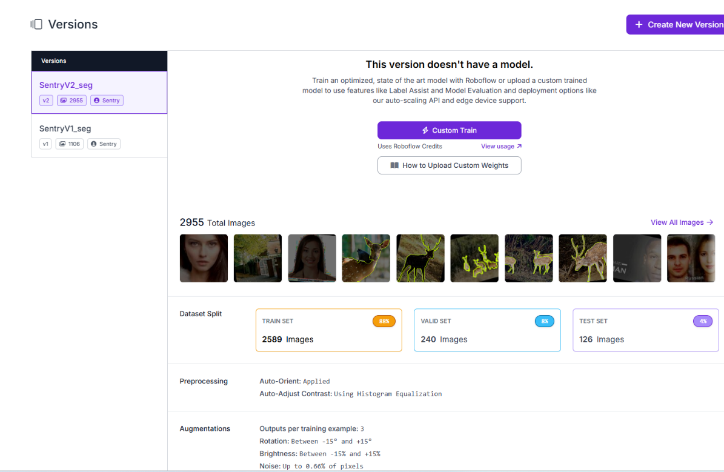
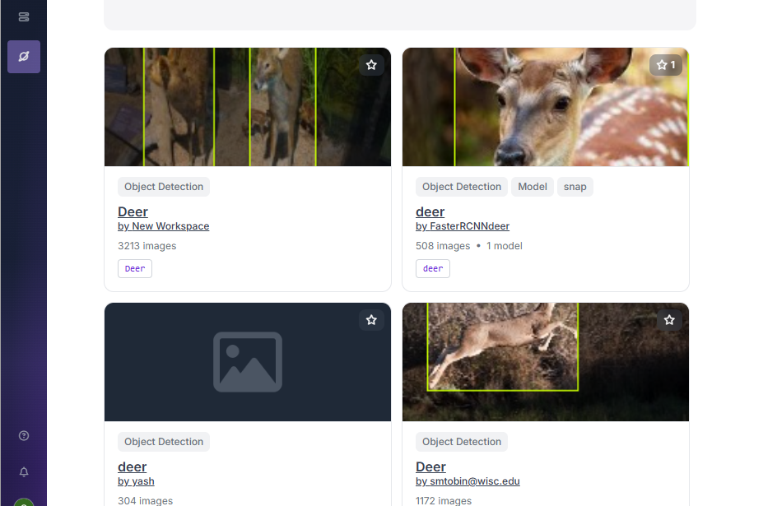

Deer dataset
Collected a dataset containing deer images in Roboflow Universe
Checked each annotions
Notes:
We got our deer dataset from roboflow universe, which is an open-source repository for computer vision that contains a vast collection of datasets. So we selected a dataset that has about 700 – 1000 images of deer in different environments. We quickly went through each image contained in our dataset to make sure the annotations were properly done.

Slide 23
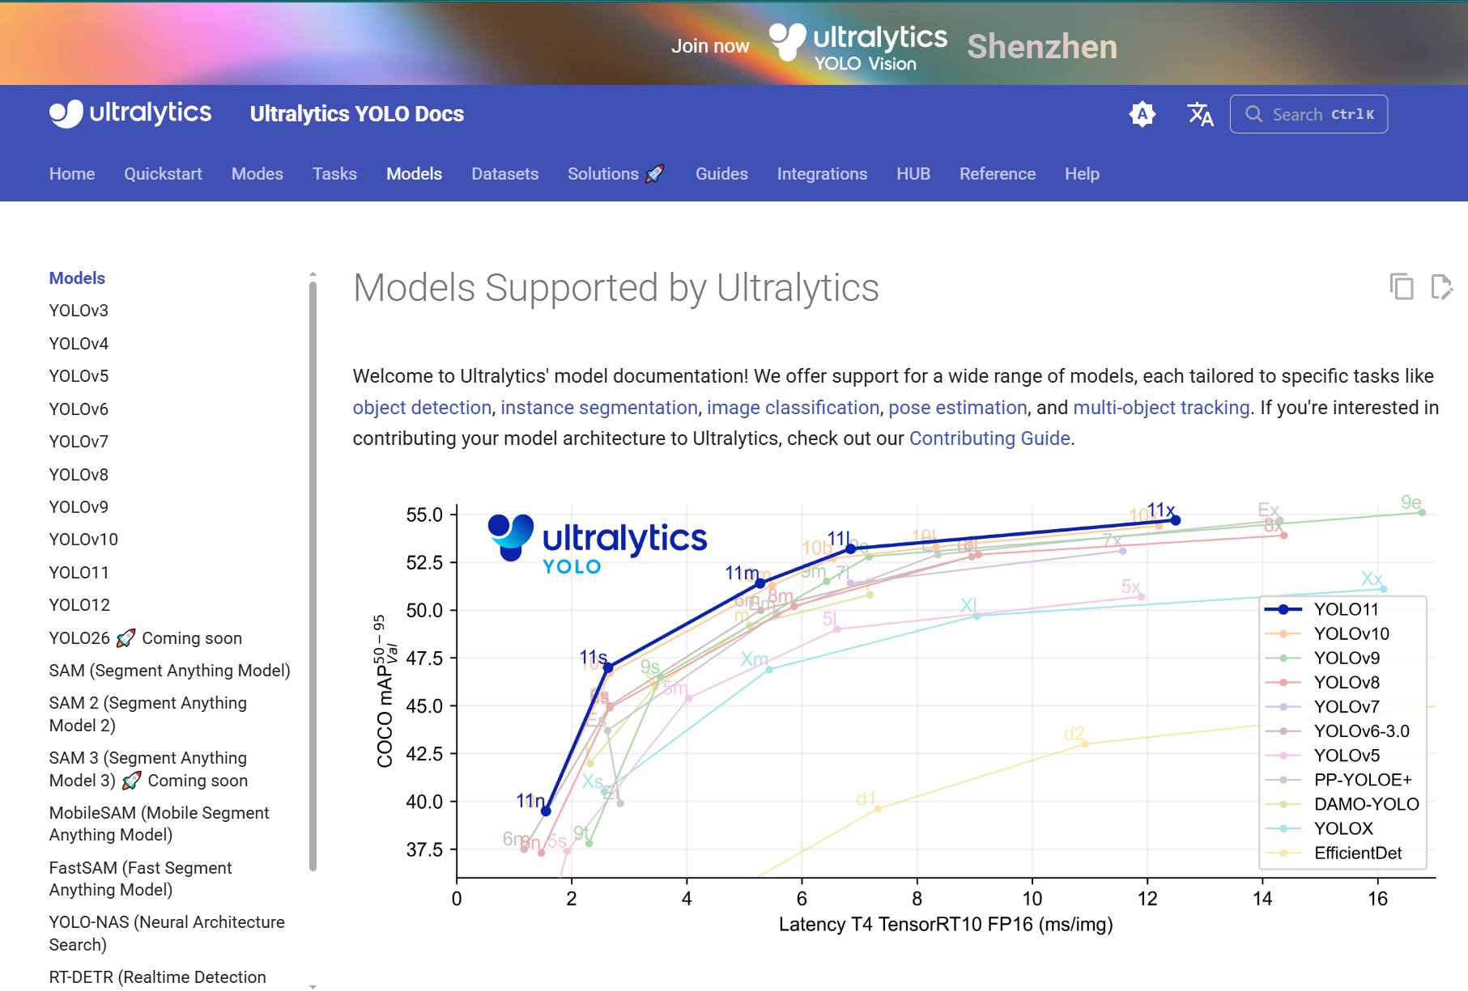
Finding a model
Notes:
After that, we looked at different computer vision models in Ultralytics and evaluated their performance, precisions, accuracy and speed. For our project we chose YOLOv8 and YOLO11 because it was the best one.

Slide 24
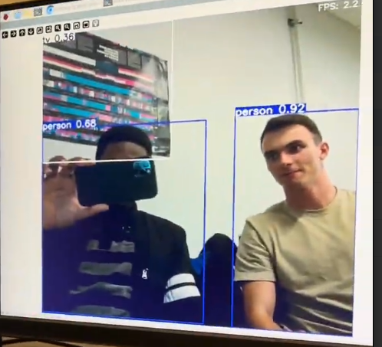
Testing YOLO 11 – pre-trained model
This model is trained on a COCO dataset
Notes:
Next up, we tested the pre-trained model on ourselves to check its performance. As show in the picture, the model detected Mark and I and displayed its confidence level, which is basically a number between 0 and 1 that tells us how sure the model is that the detections are actually people.

Slide 25
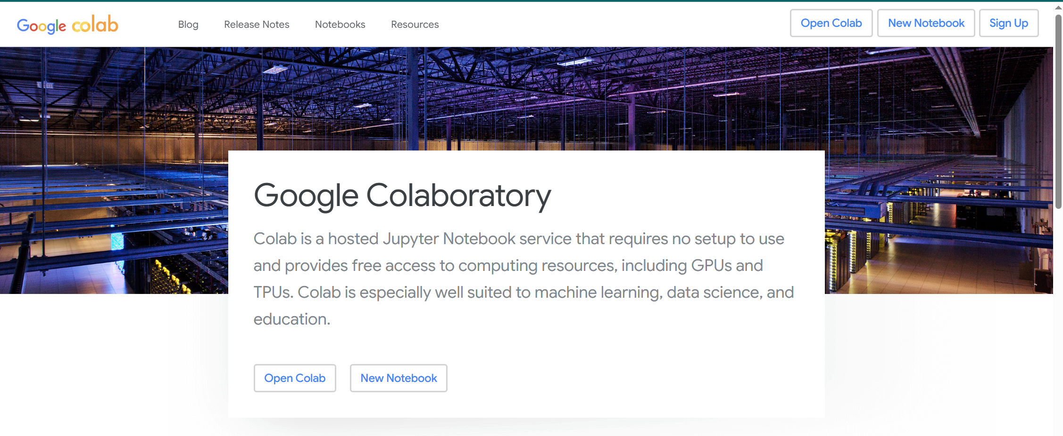
Trained our own custom model
We used google colab for training our computer vision model
Notes:
After that, we trained our models on google colab, which is a useful tool that gave us access to much faster, free GPUs. Well free up to a certain point right? But anyways, we used this tool because training on our own computers would be much slower.

Slide 26
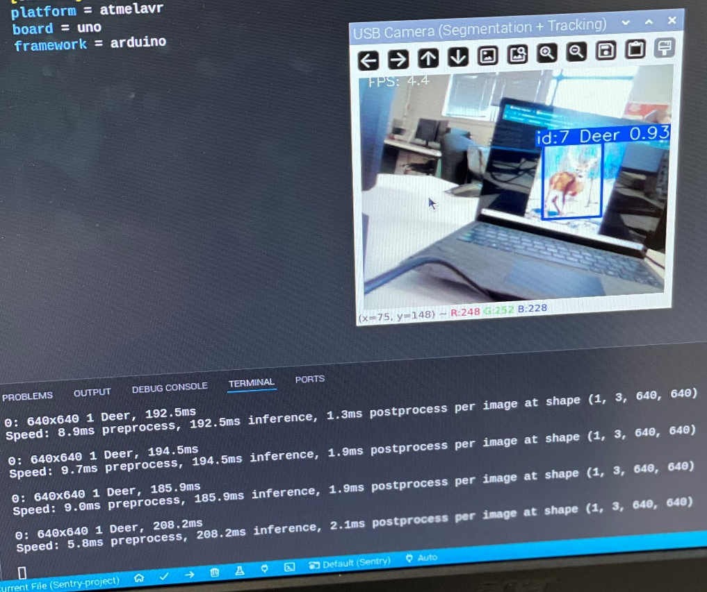
Deer detection
Detect deer and draw a bounding box
Display confidence level and tracking number
Print detection and display speed and inference time
Then what?
Notes:
When our model was ready, we programmed the raspberry pi to use it for detecting and tracking deer. As you can see in the example up here, the model detects the deer and draws a bounding box around it.

Slide 27
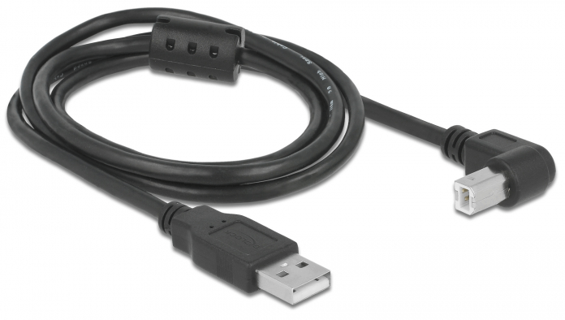
Serial Communication
Sending data through one communication single line or channel
How?
Notes:
We established serial communication between our raspberry Pi5 and Arduino microcontroller. So now we are able to send and receive data back and forth.

Slide 28
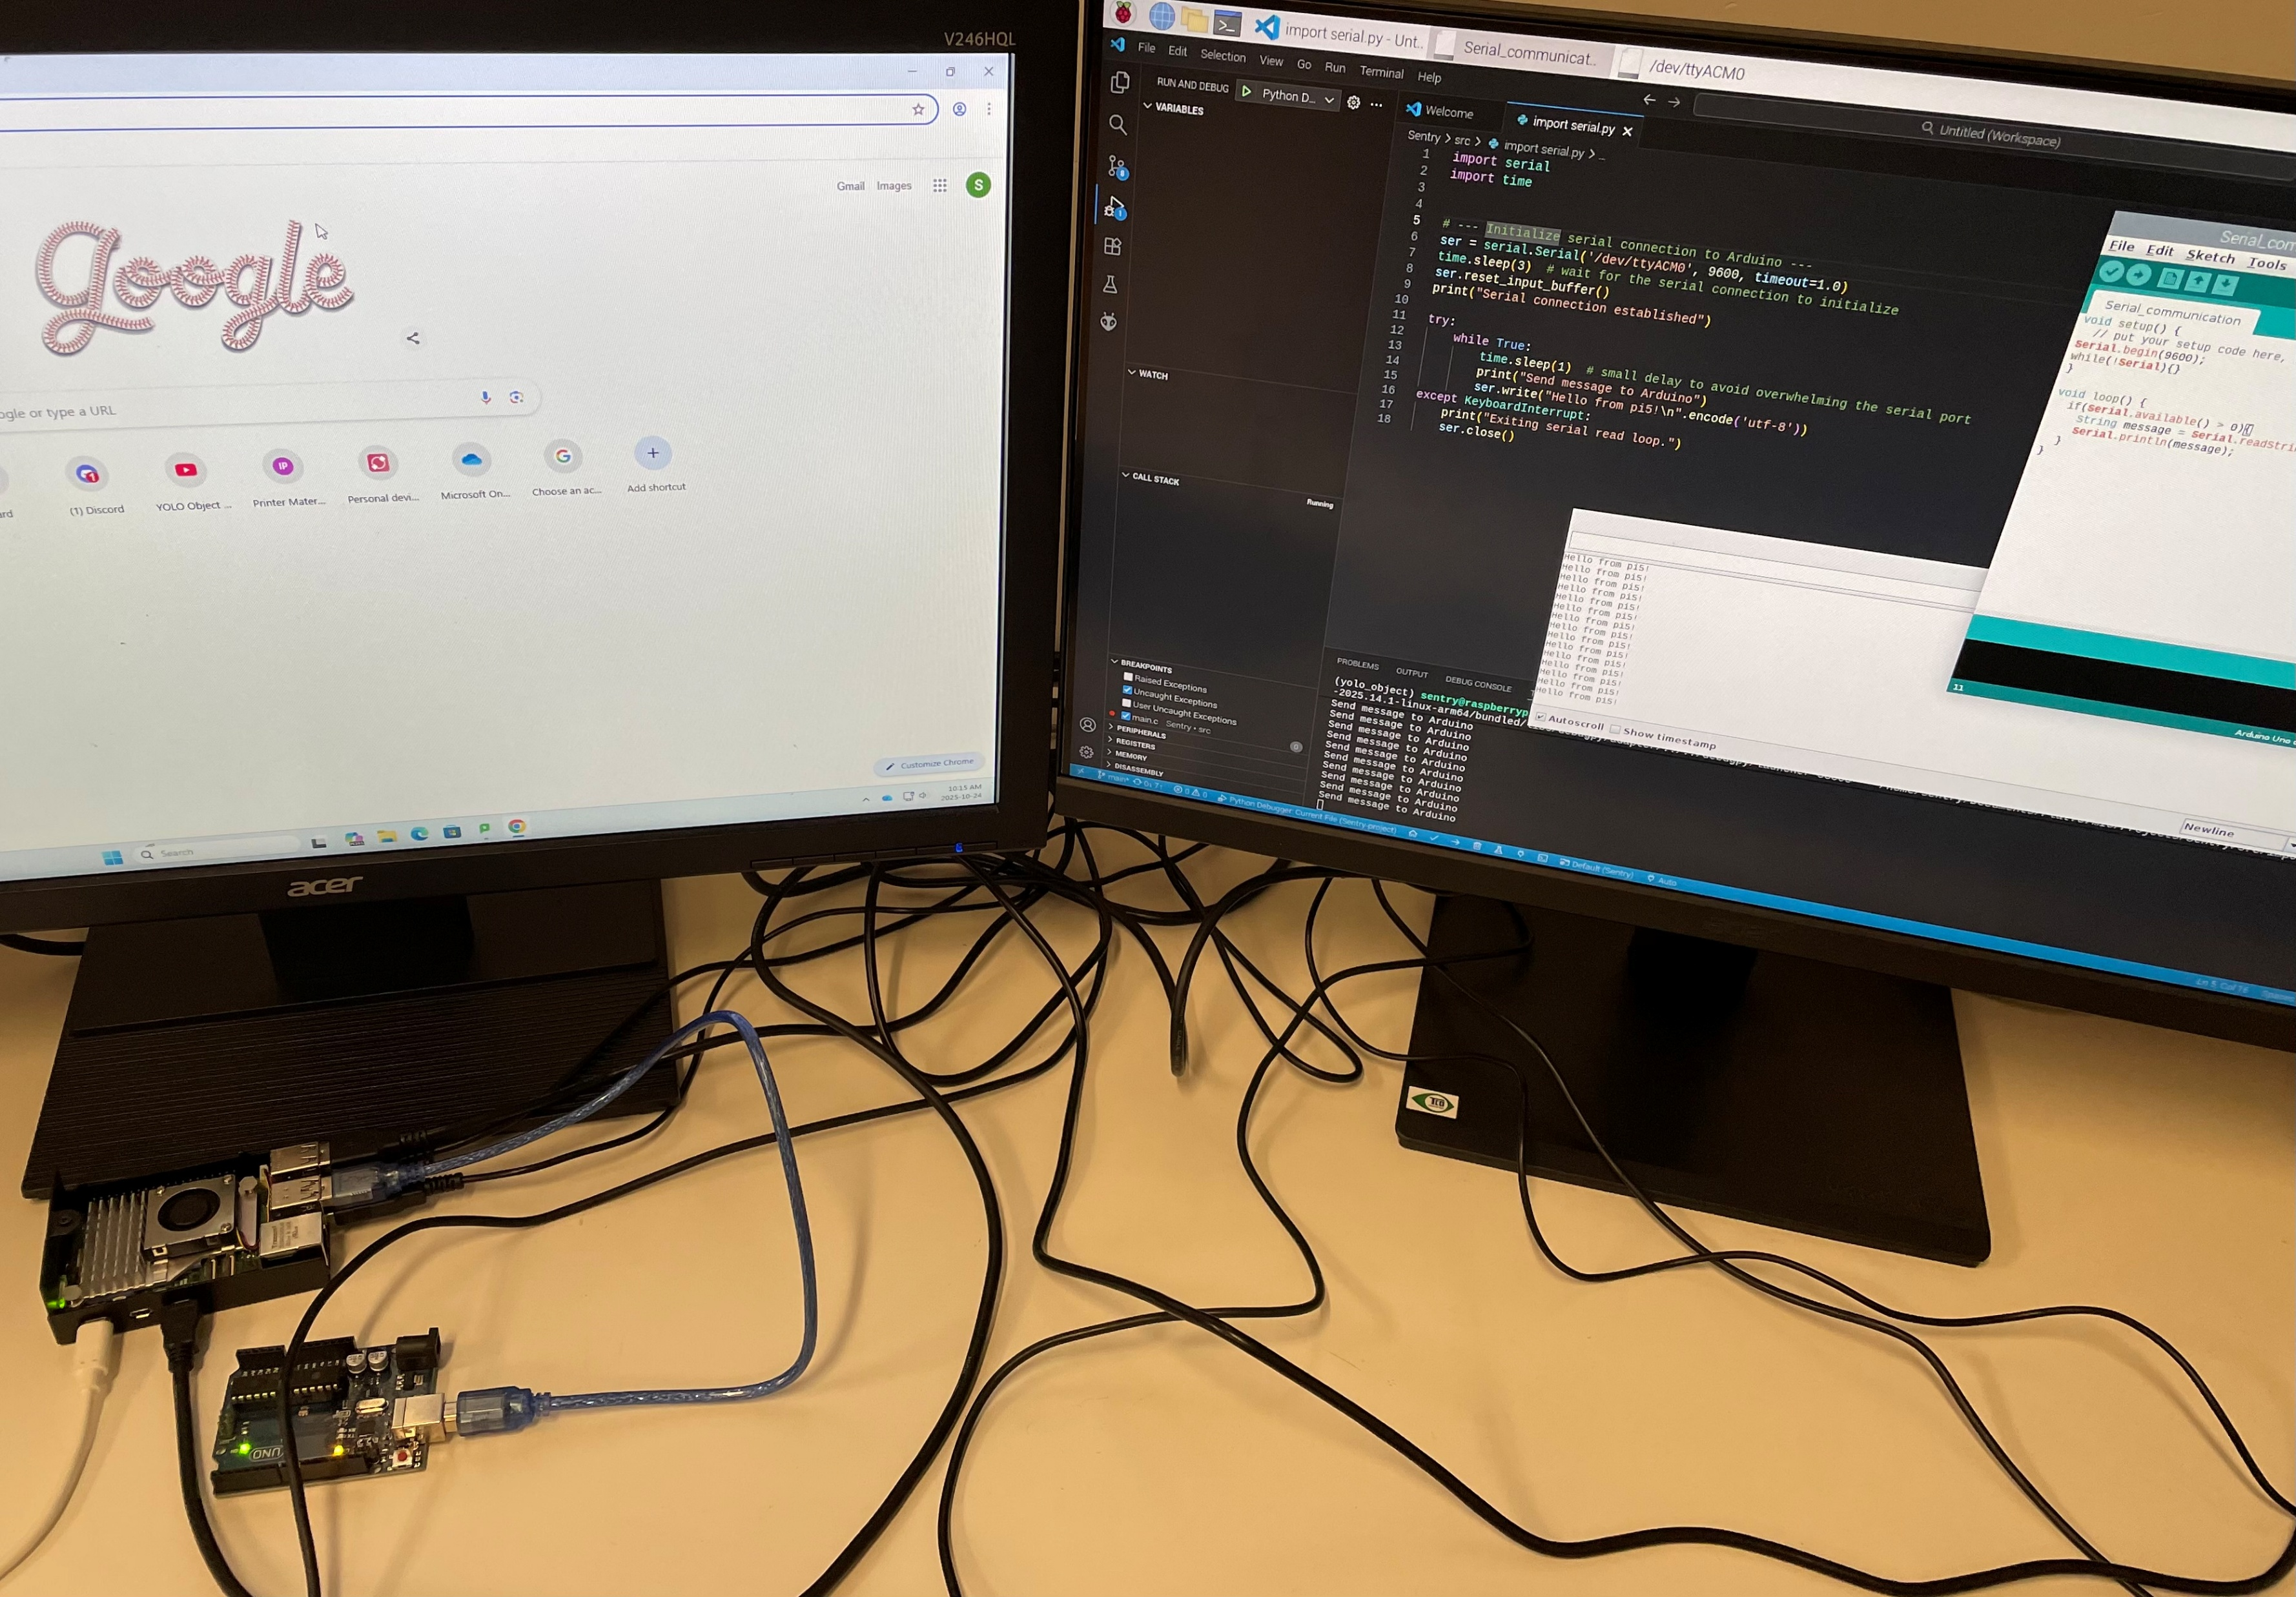
Notes:
Here is a picture that shows that. So we’re sending “Hello from pi5” and we see that we’re receiving that in the Arduino serial monitor.

Slide 29
Challenges
Model file heavy
Slow FPS
False detections
Notes:
A few challenges we’ve encountered so far while working on our project was that our model file was a bit heavy, which resulted in a slow FPS,and at times it would also give us false positives.

Slide 30
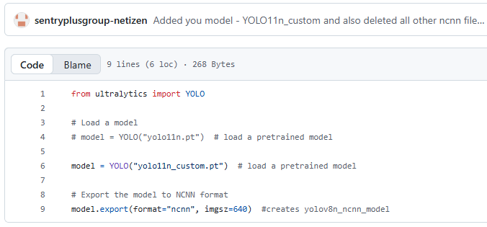
Solutions
Converted model file formats
Reduced resolution
Used image segmentation
Notes:
We resolved that by converting the format of the model file and reduced the resolution for better FPS and also used image segmentation to only annotate the exact pixels of a deer and not have other objects within the bounding boxes. We also added a Few negative samples too in our dataset, to help the model LEARN non-deer images too.

Slide 31
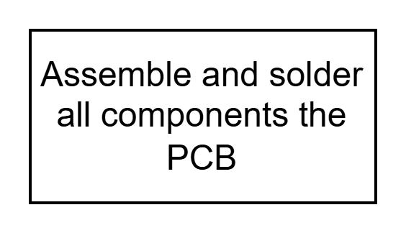
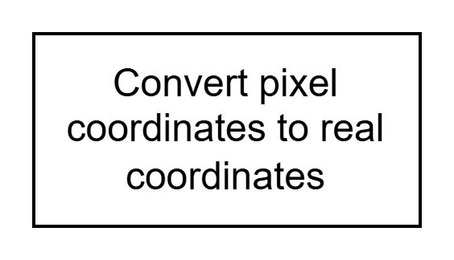
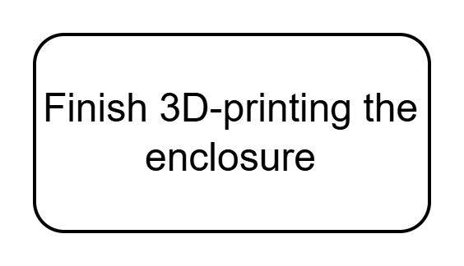
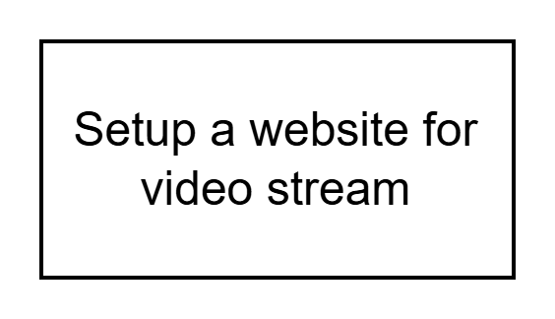
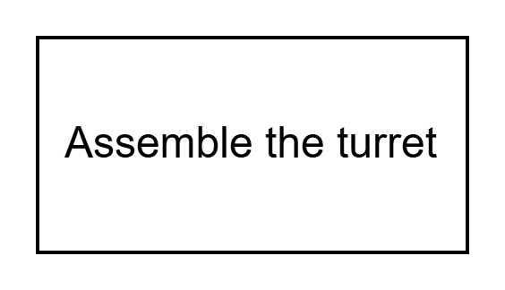
Goals for Week 9 -14
Notes:
So from week 9-14, this is what we’re going to be working on. We’ll continue printing parts of our enclosure, assemble our PCB and write the code to convert pixels coordinates into real world coordinates to be able to move our laser. So with where we’re at now, we’re pretty confident we’ll have our turret ready for the capstone symposium on the 13th of December.

Slide 32
+ + + + +
+ + + + +
Your property’s safety is our priority
Notes:
Rember this: Your property’s safety is our priority. Alright, thank you for your attention, people! Do you have any questions for us?

